Slide 1
Glug Glug…A County Office Under Water…Twice!!!
The story of the Harris County Extension Office in Houston, TX
vs.
The Tax Day Flood of 2016 & Hurricane Harvey of 2017

Slide 2
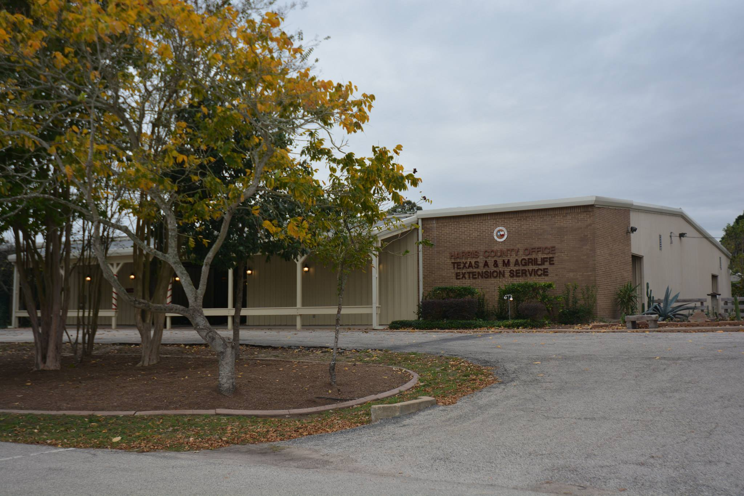
The Harris County Office at Bear Creek

Slide 3
22,150 sq. ft. building
Notes:
We were originally in for 30 years in this building with a large greenhouse and several buildings and gardens around and behind it.

Slide 4
A Portrait of the Harris County Extension Office
Built ~30 years ago in Bear Creek Park, Houston, TX
Directly behind it lay the Addicks Dam holding back the Addicks Reservoir (fed by 3 major creeks)
Rainwater frequently flooded the parking lot but the building sat up about 6 feet on an incline from there
Water had never gotten into the building…until 2016 during the Tax Day Flood – 3 FT!
And then there was Hurricane Harvey in 2017 – 8 FT!!!

Slide 5
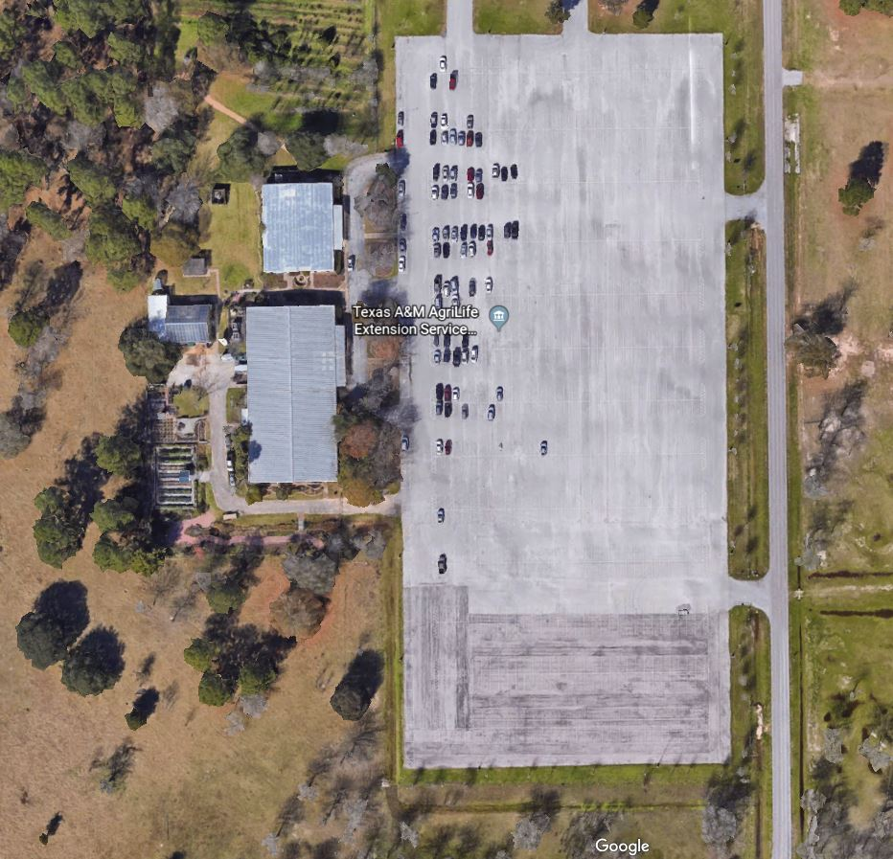
Where is the Extension Building located???

Slide 6
Tax Day Flood
Tax Day Flood of 2016 (April 17-18, 2016)
Dumped as much as 17 inches of rain in parts of Houston
Killed 8 folks
Over 700 homes and apartments were flooded as were numerous businesses and government buildings
Hwy 6 in West Houston between Clay Rd and Park Row was one of the hardest-hit areas
Bear Creek Park lies near the corner of Clay Rd & Hwy 6

Slide 7
Tax Day Flood Timeline
April 18th – I sent a mass e-mail to check on my all my Greater Houston-area county offices (22 of them)
April 19th – Allen Malone, the Harris County Extension Director, told me the Bear Creek office was in danger of flooding (water was rising 18 inches every half hour by the afternoon), so I sent another mass e-mail to gather loaner laptops from my other 41 counties to help Harris County…only 4 counties responded…

Slide 8
Tax Day Flood Timeline continued
By the end of the day on the 19^{th,} the Harris Co. Office at Bear Creek had been completely saran-wrapped and sandbagged by the Army Corp of Engineers
But the water kept rising…(‘cause opening the floodgates on the Addicks Dam would’ve flooded downtown Houston by way of Buffalo Bayou)
3 feet of water did enter…and stayed…so the Harris County Bear Creek Office had to be eventually gutted!

Slide 9
Tax Day Flood (April 17, 2016)
Notes:
Then April 17, 2016, our 2nd major flood event (out of 3) occurred.

Slide 10
Tax Day Flood (April 17, 2016)
Notes:
These pictures were taken when the staff had to be taken by airboat to salvage everything they could from the building. If you look carefully there are 3 vehicles and 2 trailers in a gated area. Not all were county owned vehicles!

Slide 11
Tax Day Flood (April 17, 2016)
Notes:
When the water receded, the office was not only a mess, it was considered destroyed and needed to be gutted completely.

Slide 12
Tax Day Flood (April 17, 2016)

Slide 13
Tax Day Flood (April 17, 2016)

Slide 14
Tax Day Flood (April 17, 2016)

Slide 15
Tax Day Flood (April 17, 2016)
Notes:
Next slide is Renovation

Slide 16
Thanks to Steve…
Before Steve Winner retired as their IT guy back in December 2015, he always told the Bear Creek Office folks to keep their computers on top of their desks
Because of him, ~90% of their computers were saved from the Tax Day Flood!
However, only 20 laptops were able to be initially transported on the air boat across the parking lot that was submerged in water over 6 feet deep

Slide 17
1st Temporary Location: Greenhouse Rd.
Steve Winner had already retired (of course) & Katie Kruszka hadn’t been hired yet so there was no IT guy
The building was a Harris County Community Center
The Bear Creek Office folks were given 2 rooms to set up in – 1 room held the Support Staff (& later their Xerox network printer) & the other held the Agents but the Agents couldn’t leave their stuff in it past 5pm ‘cause it was being used by other groups at night

Slide 18
Greenhouse Rd. from a staff perspective
Their “office furniture” consisted of card tables and chairs borrowed from the Community Center
Everybody had to use the 20 laptops that were rescued by air boat from the Bear Creek office
A lot of the Support Staff had never used laptops before so there was much crying and gnashing of teeth trying to use touchpads and small keyboards with even smaller keys (and no number pad)

Slide 19
Greenhouse Rd. from an IT perspective
Again, no local IT guy had been hired yet so they called on me as the Southeast Regional IT Specialist
I emptied my office of 24-port network switch boxes, small router boxes, network cords, power cords, monitor cords, monitors, keyboards, mice, scanners, printers, surge protectors, and even my folding banquet table but only 1 loaner laptop (my other was loaned out)
I stuffed it all in my Extension Vehicle and drove to Houston to meet John Thomas (Harris Co. network guy)

Slide 20
Greenhouse Rd. Timeline
April 21st-22nd – I met with John on the 21st & we were able to rig up ~18 laptops with local user profiles & hook them to the Harris Co. network (using his list of static IP addresses & my 24-port network switch) so Outlook 2010 & Lync 2010 could be configured for each user & 2 small network printers could be set up
I also started passing out monitors, keyboards, & mice to all the laptop-phobic folks on the 22nd

Slide 21
Introduction to AgDrive for the Bear Creek folks
Since all the laptops at Greenhouse Rd. were hooked to the Harris Co. network, they were off the AgNet domain, so their P, S, & W drives couldn’t be reached
Back at my office on April 25^{th,} I got info from AgIT on how the Harris Co. folks would access their P, S, & W network drives…using AgDrive on the web!
But, there was a STEEP LEARNING CURVE for them & for me since my own AgDrive on the web didn’t work

Slide 22
Greenhouse Rd. Timeline continued (on trip 2)
April 27th-29th – I finally got AgDrive to work for the Bear Creek folks! – after AgIT got it re-directed to the correct server
I got their new Xerox printer/copier set up on all the laptops along with their new HP OfficeJet printer
I also installed any other needed software & took 3 broken laptops back with me to fix/update

Slide 23
Greenhouse Rd. Timeline continued (on trip 3)
May 1st-May 30th – helped the Bear Creek folks remotely with various issues & fixed the 3 laptops
May 31st-June 2nd – drove to Houston again to check in with the Harris Co. folks in person since I’d be leaving for a week for NETC2016 in Orlando, FL
Helped fix various issues & dropped off the 3 laptops
Saw the old Bear Creek office gutted down to the studs
Saw the new temp location (but moving in was delayed)

Slide 24
Renovation Starts at Bear Creek

Slide 25
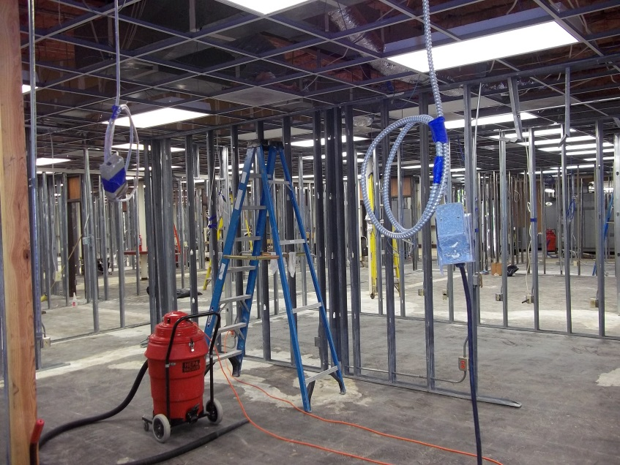
Notes:
Next slide is the before/after of the greenhouse

Slide 26
2nd Temporary Location: Pech Rd.
Katie Kruszka wouldn’t be hired for at least a month so there was still no IT person!
The building was a Harris Co. Driver’s License Office
The Bear Creek folks were given the entire 3rd floor!
Everybody got a real desk and a real chair!
Rooms were large but few so each dept. had a room
4-H, Ag/NR, FCH, Hort/MGs, Reception Area, & Print Room
CED Allen Malone & his Office Mgr actually had offices!

Slide 27
Pech Rd. from a staff perspective
Everybody had their desktops with dual monitors again along with their own desk phones!
And they had their own local printers/scanners!
Even though all the furniture was from Harris Co. Surplus or what the last folks had left behind, it was much appreciated (no more card tables & chairs!)
Program meetings still had to be held elsewhere but there was at least a kitchen & a small meeting area

Slide 28
Pech Rd. from an IT perspective
Again, no local IT person had been hired yet so they called me as the Regional IT Specialist
Since I had emptied my office for the Greenhouse Rd. temp location and they’d moved it all to Pech Rd., I ended up taking a lot of stuff back with me but I still brought extra cords, keyboards, & mice just in case
This time the Harris Co. network folks were able to set up an actual server rack for all the desktops & phones

Slide 29
Pech Rd. from an IT perspective continued
All the desktops now had DHCP so it was plug/play
I helped folks set up their desktops, dual monitors, printers/scanners, keyboards, & mice (‘cause they had actual desks again!)
However, since all the desktops were hooked up to the Harris Co. network, they still were off the AgNet domain they had been using at Bear Creek so AgDrive still had to be used to find files on the P, S, & W drives

Slide 30
Pech Rd. Timeline
June 15th-17th – I helped the Bear Creek folks get set up at the new Pech Rd. temp office
The Office Mgr’s A&M desktop didn’t survive being in storage for over a month so I had to manually copy her files from her desktop using DOS ‘cause it wouldn’t boot to Windows (and I had no USB HDD reader)
That took 3 days ‘cause I had forgotten my advanced DOS commands & could only copy each sub-directory separately until I got to the end of the sub-directories

Slide 31
Pech Rd. Timeline continued (remotely and on trip 2)
June 20th-29th – helped the Bear Creek folks remotely with various issues
June 30th-July 1st – helped more Bear Creek folks with printing to the Xerox network printer & their local printers (I had set most of them up with printing to the Xerox network printer when it was moved from Greenhouse Rd. to Pech Rd. on June 15th)

Slide 32
Pech Rd. Timeline continued (on trip 3)
July 19th – I fixed the Ag/NR Secretary’s HP LaserJet printer (replaced its SSD card with a laptop HDD & re-installed the firmware from a USB thumbdrive—had to do this again 2 years later on the same model printer in the TX State 4-H Office!)
July 20th-21st – I met Ashwani at the OST office to get 2 new PVAMU desktops then set them up at Pech Rd.

Slide 33
Katie Kruszka was hired!!! & I did a happy dance!!!
Finally, I had help again in Harris County!

Slide 34
Pech Rd. Timeline continued (remotely)
Aug 8th – I talked to the “New Steve” in Harris County (Katie Kruszka started as the new County IT gal!!!)
Aug 10th – I planned a Harris County site visit to meet her in person & do the Summer 2016 Reconciliation spreadsheet for all 3 locations (Pech, EFNEP, & OST)
Aug 15th – picked up new computers for her & myself

Slide 35
Pech Rd. Timeline continued (on trip 4)
Aug 16th – I met with Katie at Pech Rd. & dropped off her new computer then went with her around the entire 3rd floor looking at each desktop & laptop we found & verifying them on my Summer Reconciliation spreadsheet – most were there, a few had been lost
I took her to Bear Creek afterwards & took more pics of the soon-to-be Server Room – she hadn’t been there yet

Slide 36
Pech Rd. Timeline continued (on trip 4 – part 2)
Aug 17th – I picked up Katie at Pech Rd. & went to meet the folks at the Harris Co. PVAMU office on Old Spanish Trail (& verify their computers on my Summer Reconciliation spreadsheet) then I took her to the Harris Co. EFNEP office to meet those folks (& verify their computers on the spreadsheet too)
While at the EFNEP office, I tried to downgrade a desktop from Win10 to Win7 then do a BIOS update but something broke & it wouldn’t boot up again!

Slide 37
Pech Rd. Timeline continued (on trip 4 – part 3)
Aug 18th – I picked up Katie at Pech Rd. then left for the Harris Co. EFNEP office to help the Agent transfer files from her desktop HDD to her laptop since her desktop had upchucked on its BIOS update & couldn’t be repaired—Katie said she had a USB HDD reader at her house so we fetched it & she got all the desktop files copied to the laptop (& it didn’t take 3 days!)
No DOS commands had to be used to copy the files!!!

Slide 38
Pech Rd. Timeline continued (on trip 5 & trip 6)
Sept 29th – I toured my new building with my boss & the D9 office folks then drove to Houston with him to tour the newly refurbed offices & server room at the Harris County Bear Creek office with the CED, Katie, & Anthony (the network cabling guy)
Oct 14th – Katie & I dismantled the old Bear Creek server cabinet & packed it into my Extension vehicle!

Slide 39
Notes:
Next slide: Bear creek Renovation done!

Slide 40
BEAR CREEK
Getting ready to go back to:

Slide 41
Bear Creek Timeline (on trip 1 & trip 2)
Nov 2nd – I picked up my boss & drove to Harris Co. Bear Creek to meet up with Katie & install the new server equipment into the new server cabinet
Nov 8th – Katie & I hooked up the data lines 1 by 1 then tested them plus all the phone lines using a laptop & a phone in all the “outer rim” rooms at Bear Creek
We kept a running list of what worked & what didn’t

Slide 42
Bear Creek Timeline (on trip 2 continued)
Nov 9th – Katie & I hooked up the data lines 1 by 1 then tested them all plus all the phone lines using a laptop & a phone in all the “inner rim” rooms at Bear Creek
We kept a running list of what worked & what didn’t
We also gave A HUGE THANK YOU to Anthony for him sending us the schematic drawing of all the lines in all the offices at Harris Co. Bear Creek!!!
You can see it at the back of this room after the presentation

Slide 43
Bear Creek Renovation DONE!!!
Before
After

Slide 45
Notes:
Next slide is the before/after of storage behind the greenhouse

Slide 46
Notes:
Next slide: Pech Rd.

Slide 48
Everybody back at BEAR CREEK again!!!
Finally!

Slide 49
Bear Creek Timeline continued (on trip 3 & trip 4)
Nov 11th then 14th-16th – Katie & I let folks get moved in while we organized the wires in the server room
We kept a spreadsheet listing all the used & un-used drops in each room along with notes on urgent issues & sent it to my boss & Anthony
We also worked with folks on their computer setups after they got everything un-boxed & put the way they wanted it ON THEIR BRAND NEW DESKS IN THEIR OWN INDIVIDUAL OFFICES—NO MORE SHARING SPACES!!!

Slide 50
Bear Creek Timeline continued (Got the conference rooms ready)
March 24th – I helped Katie with creating data ports for the conference rooms by re-routing unused data ports & switching phone ports to data ports in the server room
We tried to test the newly-made ports (but the server went down when we left for lunch—& came back up 2 hrs later)
March 27th – I finished testing & documenting the newly-made data ports while Katie dealt with the fallout from the server being down when we went to lunch on Friday

Slide 51
Pre-Harvey Timeline
Aug 22nd – per Andy Vestal in Emergency Mgmt, I reviewed the “Hurricane Tejas” TrainTraq course & critiqued it as part of the Texas Extension Emergency Management Steering Committee that I serve on
Aug 23rd – per the Harris Co. CED, the Office Mgr sent out a flood warning for the Bear Creek office folks (Katie forwarded it to me)
Per my discussion with Katie, she then e-mailed AgIT’s network folks & copied my boss (he copied more folks)

Slide 52
Tropical Storm Harvey became HURRICANE HARVEY on August 24th
I had 43 “use it or lose it” vacation hours so I was gonna take the afternoon off on Aug 24th & be gone till just after Labor Day but…I lost it anyway because…

Slide 53
1 Day Before Harvey Came Ashore: Getting ready for possible flooding
Aug 24th – Per Katie, the Bear Creek Office folks were told by their Office Mgr to put EVERYTHING 3FT UP OR HIGHER in case of FLOODING worse than before
Also, to take anything personal home
If you wanted to take your computer equipment home, then YOU WERE RESPONSIBLE FOR IT if it was damaged

Slide 54
Hurricane Harvey of 2017
CAME ASHORE Aug 25th as a CATEGORY 4 HURRICANE
Harvey then STALLED, with its center over or near the TX coast FOR 4 DAYS dropping HISTORIC amounts of RAINFALL of MORE THAN 60 INCHES over SE Texas
$125 BILLION in damage just in the Houston Metro Area, primarily from catastrophic rainfall-triggered flooding
Killed 68 folks (only before 1919 had a storm killed more) – 1900 Galveston Hurricane killed thousands!

Slide 55
Harvey Timeline FULL EVACUATION MODE
Aug 25th – Per Katie, the Bear Creek Office went into FULL EVACUATION MODE (everything that wasn’t nailed down was being taken—including servers that had to be remotely shut down first)
Server & Firewall shutdown at noon
HARRIS COUNTY BEAR CREEK OFFICE FULLY EVACUATED just a few hours later
The Addicks Reservoir would soon FLOOD the Harris County Bear Creek Office WITH 8 FEET OF WATER!!!

Slide 56
A pretty storm… is a dangerous storm…
5 days later, it’s still raining hard in Houston and the whole area in clouds east of the eye
Just before landfall Friday August 25, 2017

Slide 57
Harvey Timeline continued: the Harris CED called a meeting…
Sept 1st – Katie & I discussed the conference call she’d just gotten off of (the Harris CED was trying to quell rumors & give as much info as he had at the time)
Per Katie’s recommendation, I sent a request to have AgDrive access activated again for the Bear Creek folks since they were destined for yet another temporary office (this would be their 3rd temporary office after being back at Bear Creek for only 9 months!)

Slide 58
Harvey Timeline continued
Sept 5th – per Katie, AgDrive up & running again for the Bear Creek folks & they are still using it to this day
Katie & I discussed possible temporary office locations (Greenhouse Rd. & Pech Rd. were no longer available)
Sept 8th – I sat in on the Head of Extension’s “Rebuild Texas” conference call to all the Agents in Harvey-affected counties – there would be 54 of them declared disasters – out of 254 total counties in TX

Slide 59
Meanwhile, back in Addicks…

Slide 65
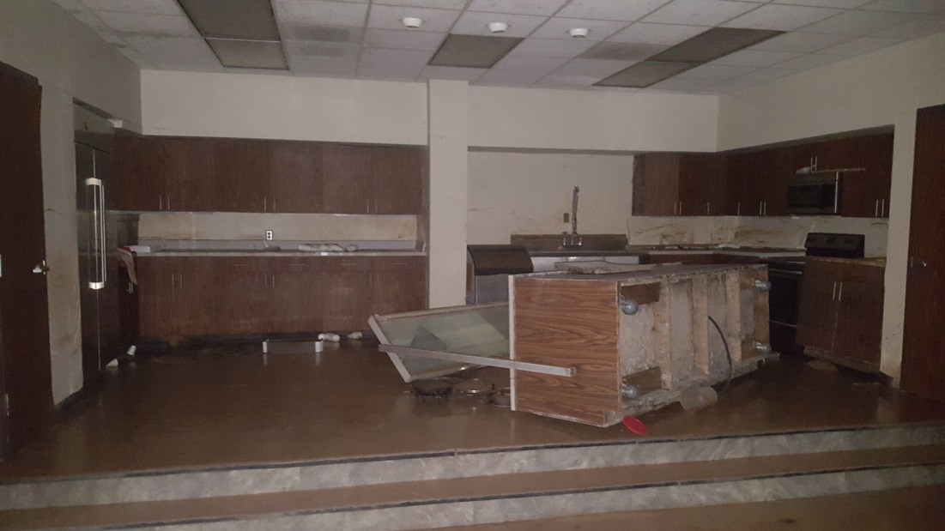

Slide 67
The Cactus Garden

Slide 68
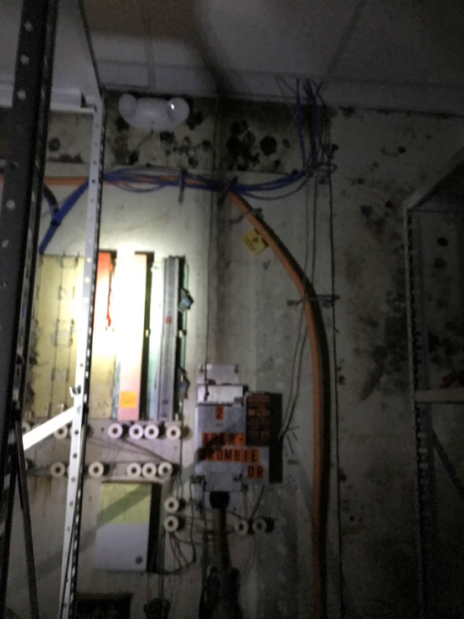

Slide 69
3rd Temporary Location: NW Houston PVAMU Campus
This time I didn’t have to set up a temporary office for the Bear Creek folks by myself ‘cause I had a Katie!
The building was the Northwest Houston campus of Prairie View A&M University (not TAMU)
After talking with Katie on the phone, I emailed Ashwani to get more info on what network stuff might be available for the Bear Creek folks there
Bear Creek folks were given 1 room, a reception area, & 1 tiny office (the CED & the Office Mgr would share)

Slide 70
NW Houston Campus of PVAMU from a staff perspective
Their “office furniture” consisted of tables and chairs in the classroom most of them were in
Everybody had their desktops but the tables adjoined each other in an inner “U” and an outer “U” with the print room guy squished next to the network printer
Only 3 phones were set up in the main room, 1 was set up in the reception area next door, and 2 in the tiny office just off the reception area that served 4 offices

Slide 71
NW Houston Campus of PVAMU from an IT perspective
Katie & I had no control over the networks other than helping the PVAMU IT folks duct-tape down their Ethernet lines all over the carpet & the tables in the main room from their 2 24-port network switch boxes
The PVAMU IT folks decided a smaller network switch box would serve the reception area & a splitter would serve the tiny office—luckily everything was DHCP
AgDrive back in service again!

Slide 72
NW Houston PVAMU Campus Timeline (before & after trip 1)
Sept 11th-12th – Katie & I tried to coordinate network setup with our PVAMU IT contact & his co-workers
Sept 13th-15th – I helped Katie with move-in & setup of the Bear Creek folks at their new temporary location
Sept 18th – Katie & I discussed me NOT going back to the temp location till the PVAMU network folks finished working on the phone setup (they had to configure the phones to pick up Bear Creek numbers)

Slide 73
NW Houston PVAMU Campus Timeline continued (remotely)
Sept 21st-22nd – Katie & I discussed what equipment was lost due to Harvey
The Entomology Agent lost almost all his equipment except his laptop & microscopes that he had with him
he had been at a conference & was not able to save his other laptop, desktop, monitor, & printer
The vacant Ag/NR Agent position lost EVERYTHING
1 laptop on a docking station with a monitor
2 laptops & 2 projectors locked in a storage closet

Slide 74
NW Houston PVAMU Campus Timeline continued (on trip 2)
Sept 26th-28th – Katie & I finally got the list of static IP addresses from the PVAMU IT folks so we set up 4 network printers then started hooking Bear Creek folks up to them
Hooked 20 of them up to the Xerox network printer
Hooked some up to a color printer & a few to Katie’s printer in the reception area (the tiny office had 2 local printers so the CED & Office Mgr could print privately)

Slide 75
NW Houston PVAMU Campus Timeline continued (on trip 3)
Nov 29th – Katie & I toured the old Bear Creek building with the other Bear Creek folks for just a few hours
Power had not (& would not ever!) be restored so we all used flashlights and headlamps
Mold & mud was everywhere so we all wore boots, masks, gloves, & I wore my dad’s old coveralls
Katie & I were able to salvage 3 laptops that had been locked inside a Pelican case on a top shelf in the server room—the case had floated off the shelf & was on the floor but the laptops were unharmed!

Slide 76
Packed in like sardines!
As of today, the Bear Creek folks are still at that 3rd temporary office

Slide 79
Where will they go next?
The Astrodome has been mentioned…

