Slide 1
June 18-21, 2018
Blacksburg, Virgina
Motivate Your Mind With Healthy Habits in the Workplace
Extension Agents
Amy Mullins & Molly Jameson
Notes:
both

Slide 2
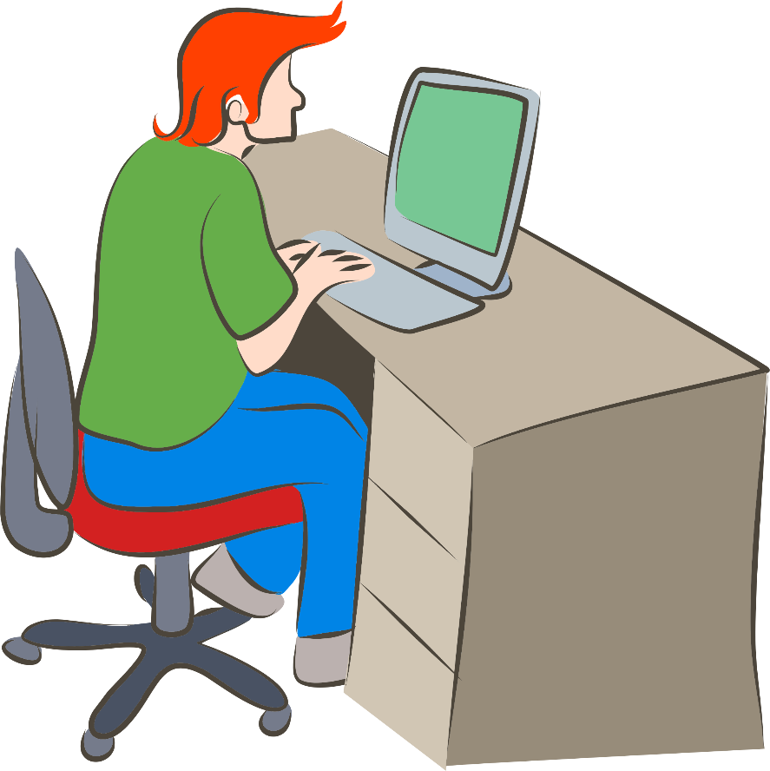
Time to Go to Work!
How many hours a week do you spend sitting?
Extension ROCKS!
HELP
AGENTS
1.Molly
2. Amy
3. Mark
4. Heidi
Notes:
Molly

Slide 3
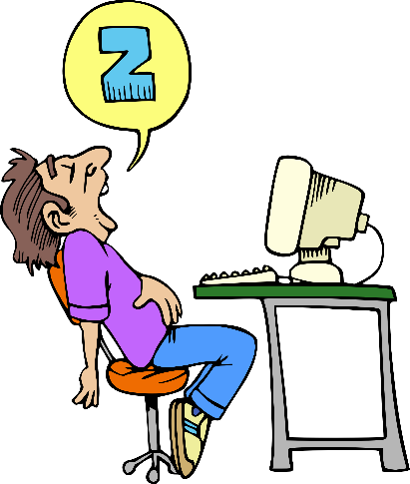
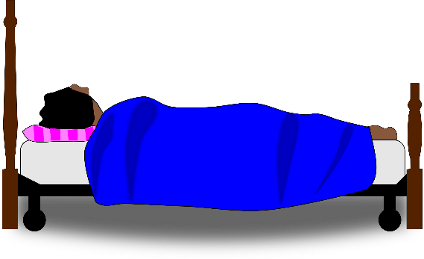
…A Lot!
Americans sit an average of 13 hours a day and sleep an average of 8 hours = 21 hours being sedentary!
Research shows we should be standing THREE minutes for every ONE we sit…
In an eight hour workday, that means we should stand SIX HOURS and sit for only TWO!
13 hours
8 hours
Way too sedentary!

Slide 4
Sitting is Killing Us!
A 2010 study published in the American Journal of Epidemiology followed 123,216 people from 1996 to 2006:
Those who sat >6 hours a day were 71% more likely to die during the time period studied than those who sat <3 hours a day!
Findings were independent of physical activity levels (negative effects of sitting were just as strong in people who exercised regularly!)
I sit less than three hours a day!
I sit more than six hours a day…

Slide 5
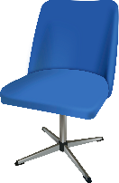
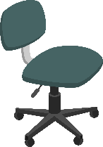
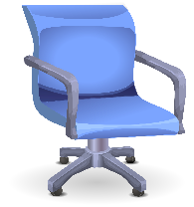
Inactivity and Health What’s the Link?
Frequent inactivity for prolonged periods of time is associated with higher rates of:
Being overweight and obese
Type-2 diabetes
Heart disease*
Stroke*
Cancer*
*Together account for over 50% of all deaths
The more time sitting daily… the higher the risk!
Notes:
*The more time spent sitting daily, the greater the risk of dying from:
Heart disease
Stroke
Cancer
According to a 2014 Harvard study of over 92,000 women; This study also mentions that regular exercise did NOT decrease the increased death risk associated with prolonged sitting.

Slide 6
It’s All Connected!
Poor Diet
Overweight & Obesity
Physical Inactivity
Chronic Disease

Slide 7
How Can We Be Healthier?
Although it can be a challenge, there are things we can do to be healthier at work:
Make work space changes and do activities to improve mood, diet, physical health, & overall productivity
Use tools to build healthy habits

Slide 8
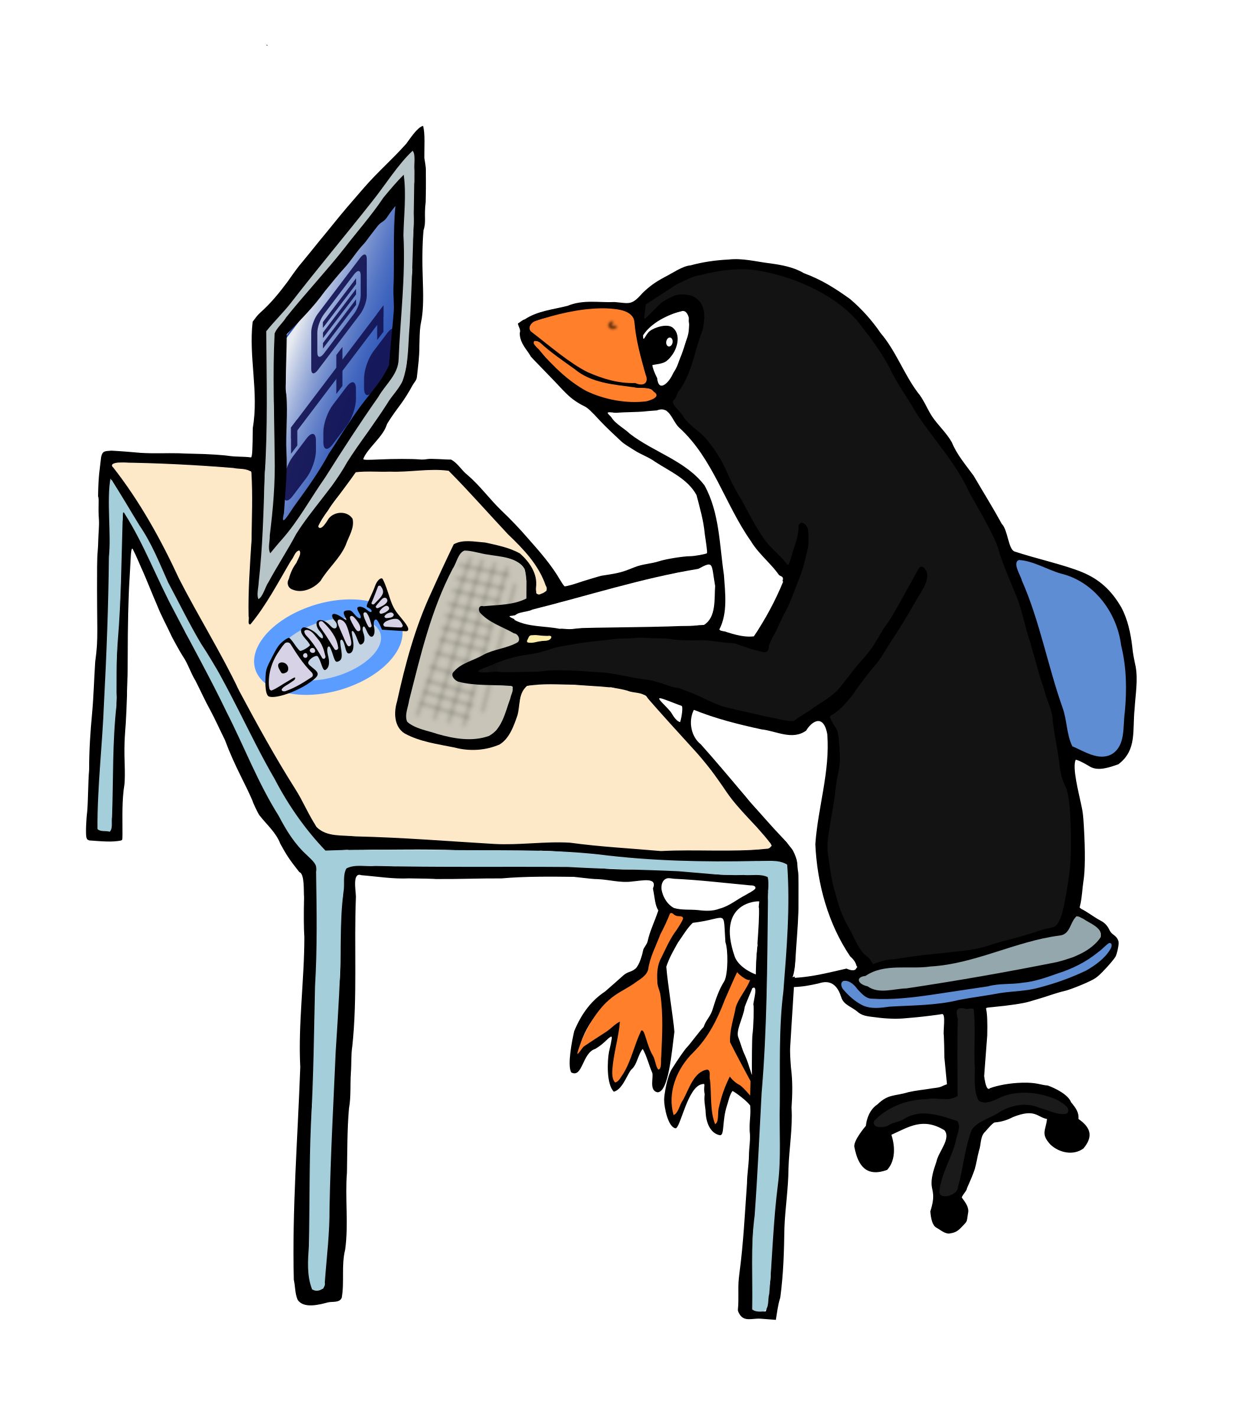
Stand Up!
Standing more each day tones muscles, improves posture, increases blood flow, ramps up metabolism, and burns extra calories

Slide 9
Calories
The fat-burning enzyme Lipoprotein Lipase increases when muscles are activated. Studies show that keeping muscles engaged supports a fat-burning metabolic state that helps improve
Cholesterol
Blood sugar
High blood pressure
Standing in place burns
30% more calories than sitting still!
Notes:
* 30% = 1.3 MET compared to1.0 MET (measurement of energy cost or physical activity)

Slide 10
Mindful Movement in the Office
Experts recommend:
Sitting no more than 20 minutes at a time
Standing still in one position for no more than 8 minutes at a time
Move More!
Instead of calling or emailing a co-worker in your office, take a stroll down the hall!
On a conference call? Stand, move, stretch, squats, desk push-ups
Take the stairs as often as you can
Be creative on your feet and schedule walking meetings

Slide 11
Mental Energy
Besides the physical benefits, moving around more often can:
Improve your mood
Increase mental energy
Reduce fatigue
Studies have shown standing up and walking even just 5 min/hour lifts mood, combats lethargy without reducing focus, and can even dull hunger pangs

Slide 12
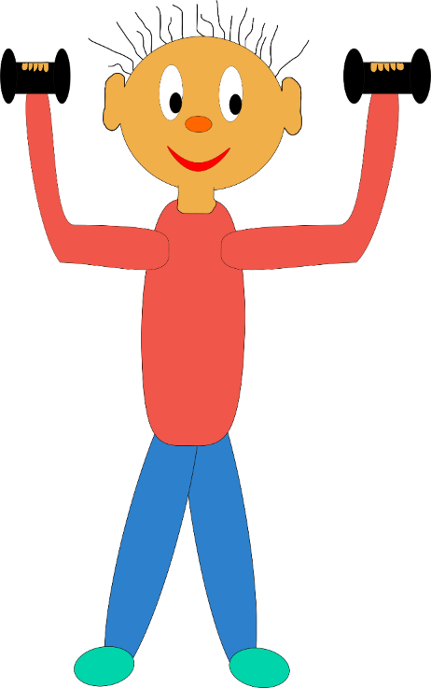
Office Exercises
Consider getting an exercise mat, stretch band, light weights for the office
Or just stretch! (no equipment required!)

Slide 13
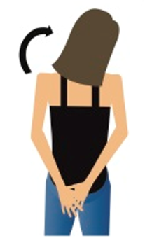
Stretch Your Muscles
Straight Up
Pump it Up
Fingers interlaced, pull arms over head with palms reaching up. Hold for 10-15 seconds.
Arms above head, grab ahold of opposite elbows, lean side to side. Hold 8-10 seconds each side.
Shoulder Neck Tilt
Arms behind back, grab wrist with opposite hand and pull while tilting head to the side. Reverse and repeat. Hold for 10-12 seconds per side.

Slide 14
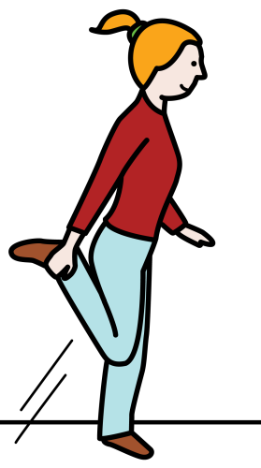
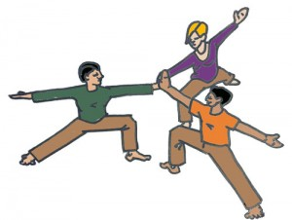
Be A Warrior
The Twist
Quad Stretch
Warrior
Cross one leg over another, take opposite arm to knee, twist towards open side. Hold for 8-10 on each side.
Warrior II pose strengthens the shoulders, arms, feet, ankles and legs, and stretches the ankles, legs, groins, chest and shoulders.
Grasp your ankle and gently pull your heel up and back until you feel a stretch in the front of your thigh. Tighten your stomach muscles and keep your knees close together. Hold for about 30 seconds.
Switch legs and repeat.

Slide 15
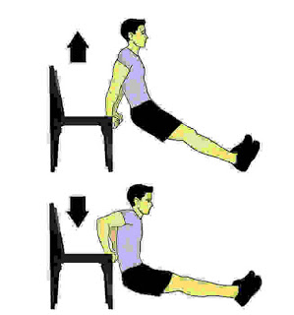
Flex Your Muscles
Desk Tricep Dip
Wall Squat
Desk Pushups

Slide 16
Give Yourself a Hand

Slide 17
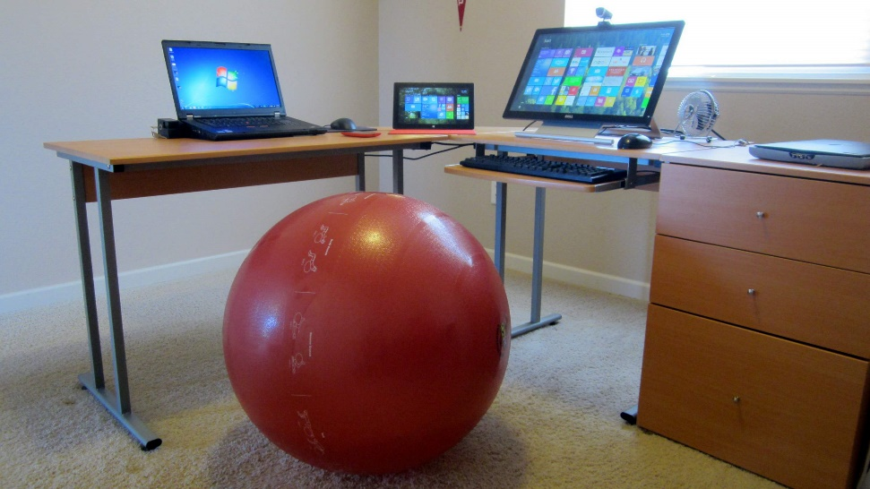
Get on the Ball
Alternate sitting in a chair with sitting on a stability ball​
Activates core muscles
Encourages movement
Encourages productivity
Schedule reminders!
Stand up and walk around hourly

Slide 18
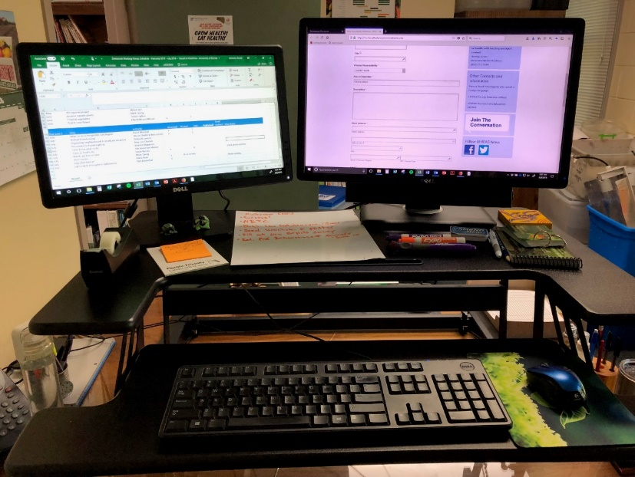
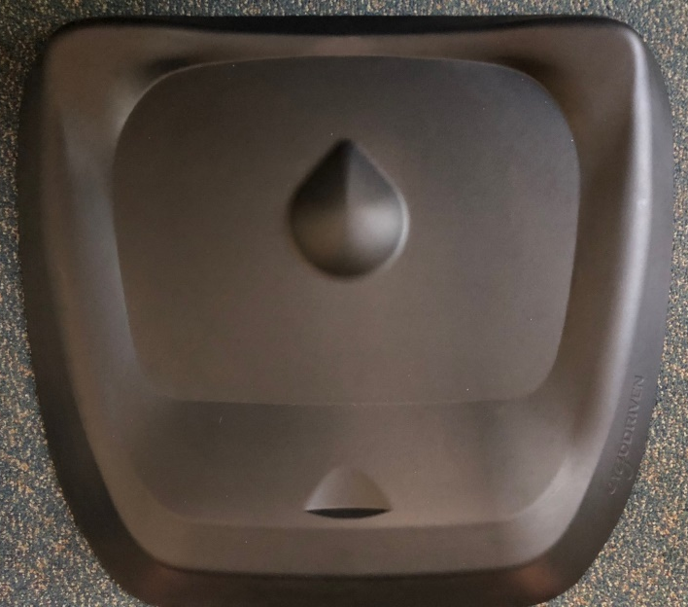
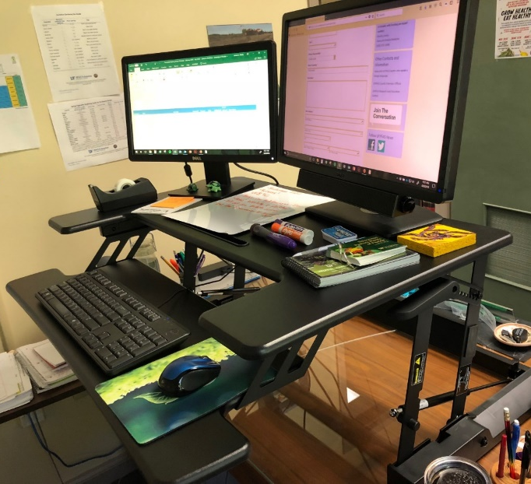
Stand-Up Desks
67% of US office workers wished their employers offered them desks that could be adjusted so they could work seated or standing…
Consider investing in a standing desk converter and standing mat

Slide 19
Do You Have “Tech Neck”?
The human head weighs 8-10 lbs.
When slouching, your head tilts forward & down, gravity increases the weight… tilting your head 30º = ~40 lb. strain on your neck and upper spine!
Over time, this strain can lead to chronic pain, headaches, arthritis, pinched nerve, bone spurs, disc degeneration, etc.
40 lb strain on your neck and upper spine!
10 lbs

Slide 20
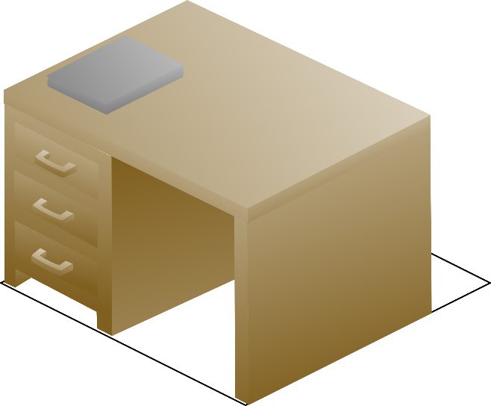
Straighten Up!
Straighten up your posture!
Move your computer screen so it is level with your line of sight
Keep your head up while texting, scrolling
See a specialists if pain persists!

Slide 21
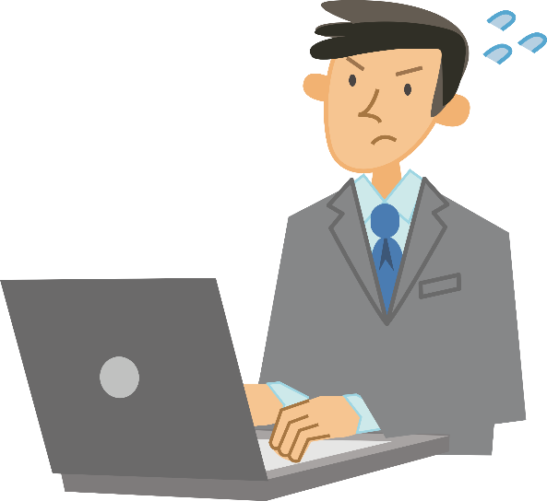
“Gamer's Thumb”
Thumb, hand, and wrist pain from repetitive stress injury caused by too much gripping, tapping, swiping, typing
#1 most searched technology related injury!
EXTENSION ROCKS!
Rely less on texting and give your thumb a rest
Switch between your left and right hands and be mindful of your texting posture

Slide 22
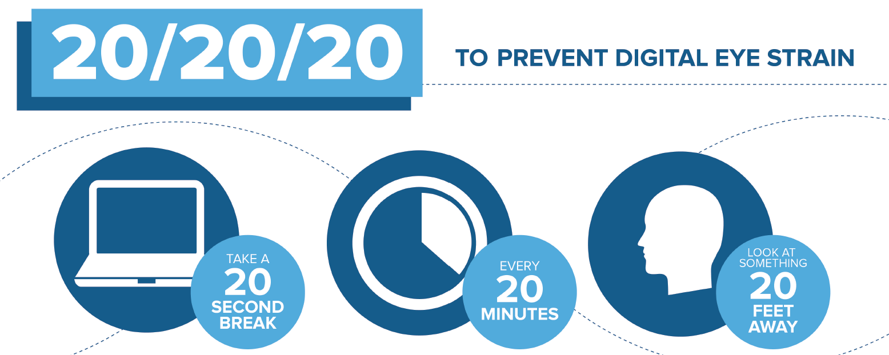
“Email Eye”
According to The Vision Council, an eye care advocacy group, >60% Americans report symptoms associated with digital eye strain: 20% eye-related headaches, 23% dry eyes, 22% blurred vision
The American Optometric Association suggests:
Infographic by The American Optometric Association

Slide 23
Schedule Breaks
Get Outside!
Replace that afternoon coffee with an energizing walk or stretch
Bike ride with co-workers
Lunchtime stroll

Slide 24
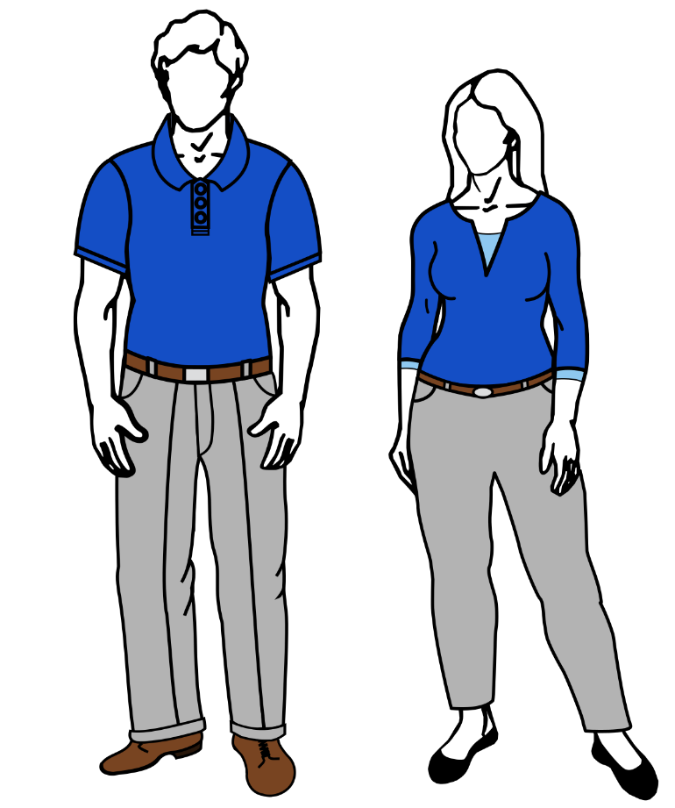
Dress for Success
Work clothes don’t have to be stuffy to be stylish!
Comfortable and non-restrictive
Shirts and pants with some stretch
Wrinkle-free or wrinkle-resistant
Shoes that are willing to be walked in

Slide 25
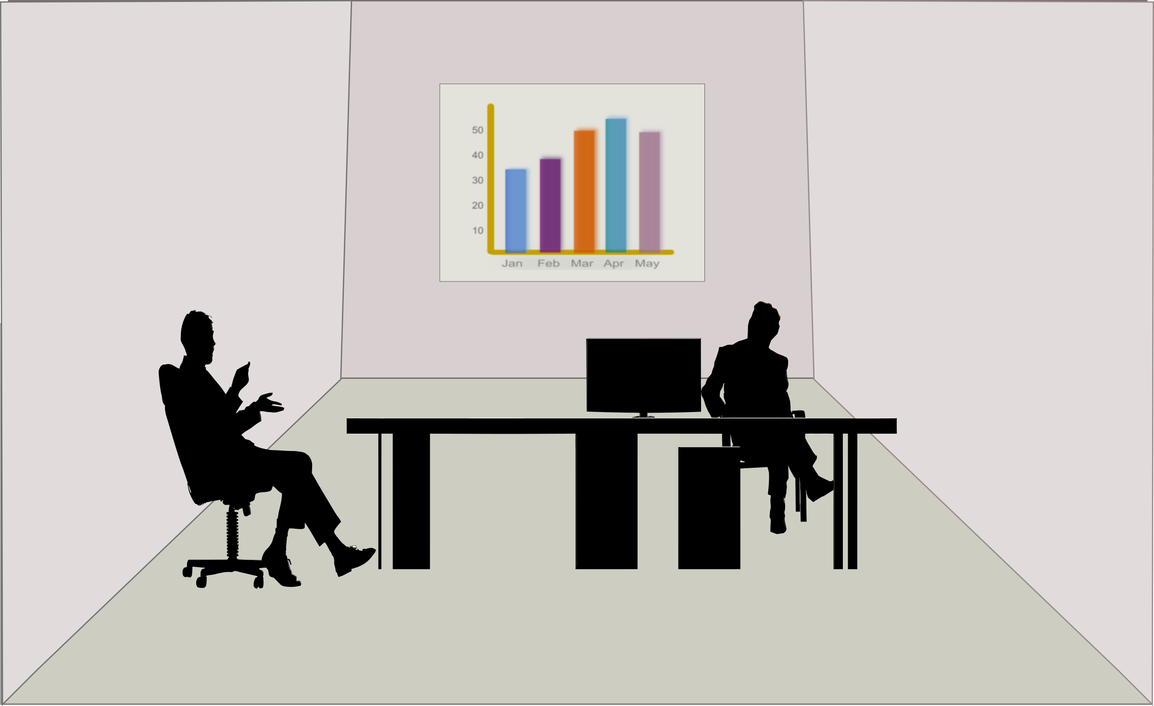
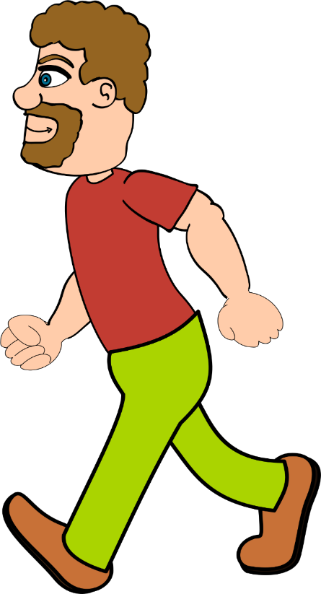
Increase Your Water Intake
8x8 Rule: Drink eight 8-oz glasses water a day
Invest in a reusable water container for your office
Drinking water throughout the day will mean standing up regularly for refills…
Extension ROCKS!

Slide 26
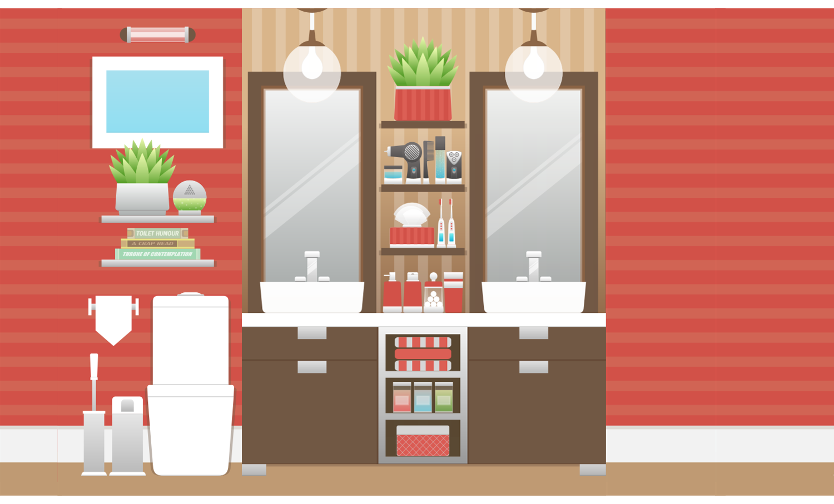
…and more standing up to go to the bathroom!
Extension ROCKS!

Slide 27
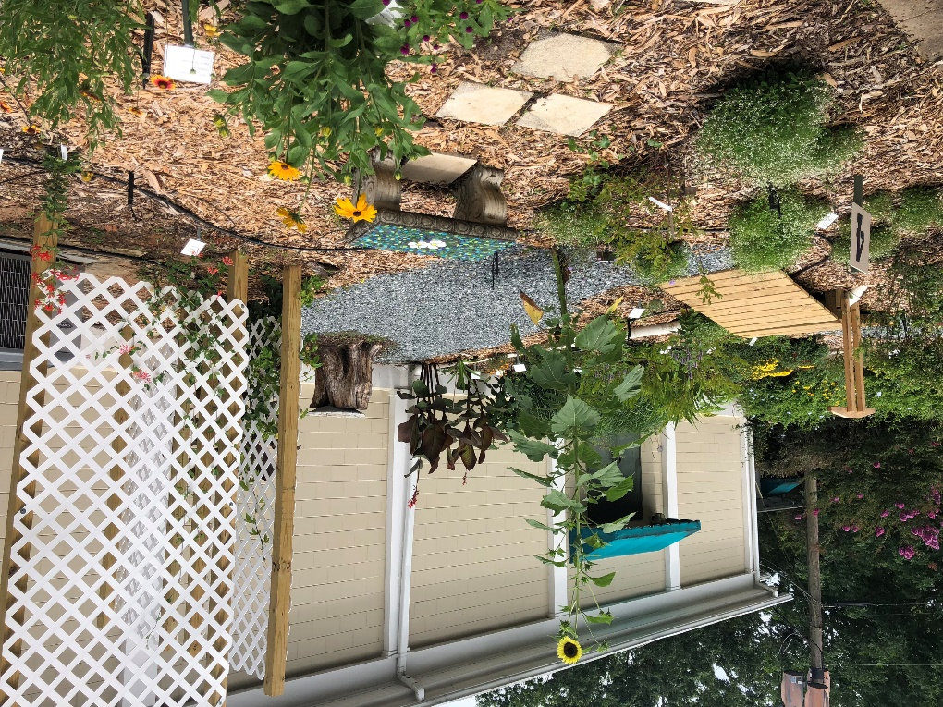
Change Office Culture
Build a culture of health with workplace wellness activities
Having a support system at work can help encourage healthy behaviors
Consider making a dedicated “active zone” for office staff
Take an active role with Extension! Office garden bed, watering, harvesting, garden walks

Slide 28
Adapt Your Space

Slide 29
Does this Look Familiar?
www.tricitymed.org/2017/05/sad-desk-lunch-infographic/
Notes:
https://www.tricitymed.org/2017/05/sad-desk-lunch-infographic/

Slide 30
The Sad Desk Lunch is Bad for You
People often eat more calories at their desk than if they dine out
They also snack more throughout the day if they stay at their desks
The average office worker has 476 calories worth of unhealthy snacks at their desk
Adapted from: www.tricitymed.org/2017/05/sad-desk-lunch-infographic/
Notes:
https://www.tricitymed.org/2017/05/sad-desk-lunch-infographic/

Slide 31
Bigger isn’t Better
Eat lunch out with caution!
Have a plan
Read nutrition information
Choose wisely
Make substitutions
Control portion size
Go small
Sharing is caring
Take half for next days lunch
Eat slowly
Take a walk

Slide 32
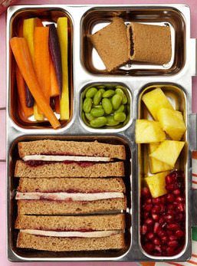
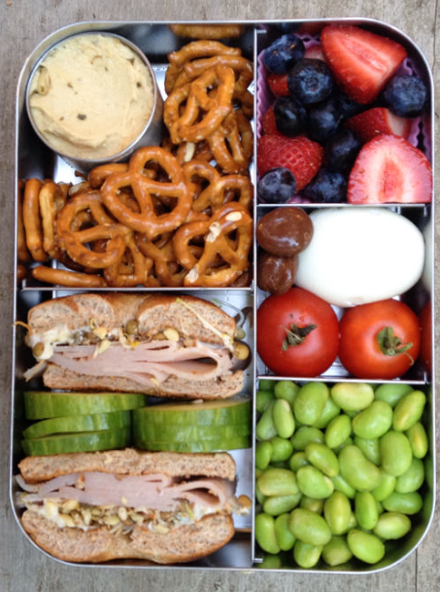
Think Inside the (Lunch) Box

Slide 33
Planning Ahead is Key
Take time to plan nutritious meals for the week!
Plan for leftovers to be used later in the week
Incorporate fruits and vegetables into each meal
Take it easy on takeout!
Pack healthy snacks to take on the go!
Chop fruits and vegetables for easy snacking later in the week
Portion out snacks into individual servings

Slide 34
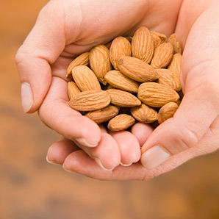
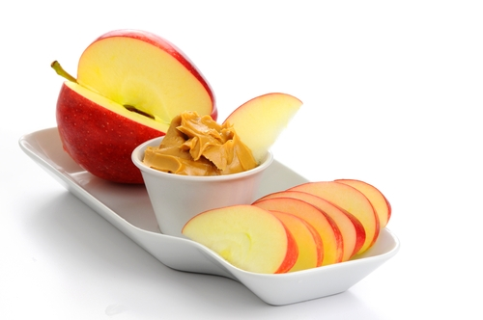
Snack Attack
Hummus and whole grain crackers
Nuts
Low-fat cheese stick
Popcorn
A piece of fruit
Yogurt
SMART SNACKS

Slide 35
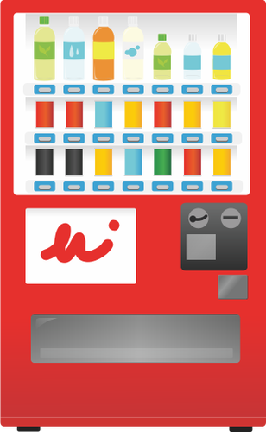
Vending Machine Snacks
Pretzels
Almonds
Trail mix
Animal crackers
Fresh or dried fruit
Fat-free or reduced-fat popcorn
Whole-grain crackers with peanut butter or cheese

Slide 36
Healthy Eating Apps
Fooducate – Healthy Weight Loss
Scans and rates foods based on ingredients
Gives explanation of nutrition content, not just numbers
Offers alternative recommendations
Tracks food intake and exercise
Innit
All-in-one platform to plan meals, create shopping lists, and get step-by-step instructions
Appliance compatible
Prepear
Social networking food app
Over 100k recipes, or add your own, collect web recipes
Create meal plans and menus
Smart grocery list
Notes:
Healthy eating can be made easier with a little help!
Fooducate
THE BEST WEIGHT LOSS APP • 1st prize - US Surgeon General's Healthy App Challenge
Innit
Innit is your Culinary GPS for everyday eating. Make everyday cooking less complicated, stressful, and time-consuming. • Simple: Plan, shop, prepare, and cook delicious meals right from your phone. • Personalize: Get delicious personalized meal recommendations based on diet, allergies, and dislikes for you and your family. • Customize: Experiment with new flavors and ingredients. Make the most of what you have in your fridge and create a smart shopping list with the tap of a button. • Confidence: Follow your inspiration, orchestrate delicious meals with ease with Innit’s guided how-to videos and real-time cooking guidance that update with every customization you make. • Connect: Make your appliances work harder and your kitchen smarter. Innit coordinates even the most complicated meals seamlessly, helping you take full advantage of the appliances you own and automatically controlling ones that are smart. • Save Time: Meal Kits you can purchase directly through Innit, delivered by Chef'd so all pre-portioned ingredients for a meal get delivered right to your doorstep, and still feature the same step-by-step guidance you love. Simple one touch payment can be made through Apple Pay, or choose to pay by credit card.
Get PrepearFree, now and always.
Prepear Features
10,000+ recipe ideas
Search filters for special diets and preferences
Fully customizable Meal Planner
Unlimited storage for every recipe you love
Friend connections and recipe sharing
Personal and collaborative recipe collections
Automatic Grocery Lists
A totally ad-free experience
Screen lock during cooking and shopping
Nutrition information on recipes

Slide 37
Stand Up Reminder Apps
Although technology can sometimes be detrimental to our health, there are some helpful tools out there, for example:
Stand Up! The Work Break Timer
Customizable, set reminder interval between 5 min. & 2 hours
Standland
Collect creatures & gems by standing up in the real world!
Awareness
Sets a timer in menu bar, counts time you’ve been active on your computer

Slide 38
Other Apps
Fabulous: Daily Motivation & Habit Goal Tracker
Breaks personalized self-improvement goals into easy steps
Makes recommendations to help you achieve goals
Hydro Coach
Build hydration into workouts
Sets goals and keeps track
Sync with fitness devices like Fitbit

Slide 39
Be Mindful
Be mindful of how you feel and how much inactivity you’ve had throughout the day
Try to make at least one or two healthy workplace changes
Discuss workplace wellness with your co-workers and boss

Slide 40
Thank you!
Questions?
Resources:
American Journal of Epidemiology
International Journal of Behavioral Nutrition and Physical Activity
JustStand.org (https://www.juststand.org)
Tri-City Medical Center (www.tricitymed.org)
Centers for Disease Control and Prevention (https://www.cdc.gov/)
American Optometric Association (https://www.aoa.org/)
Our contact information:
Amy Mullins amymullins@ufl.edu
Molly Jameson mjameson@ufl.edu

