Slide 1
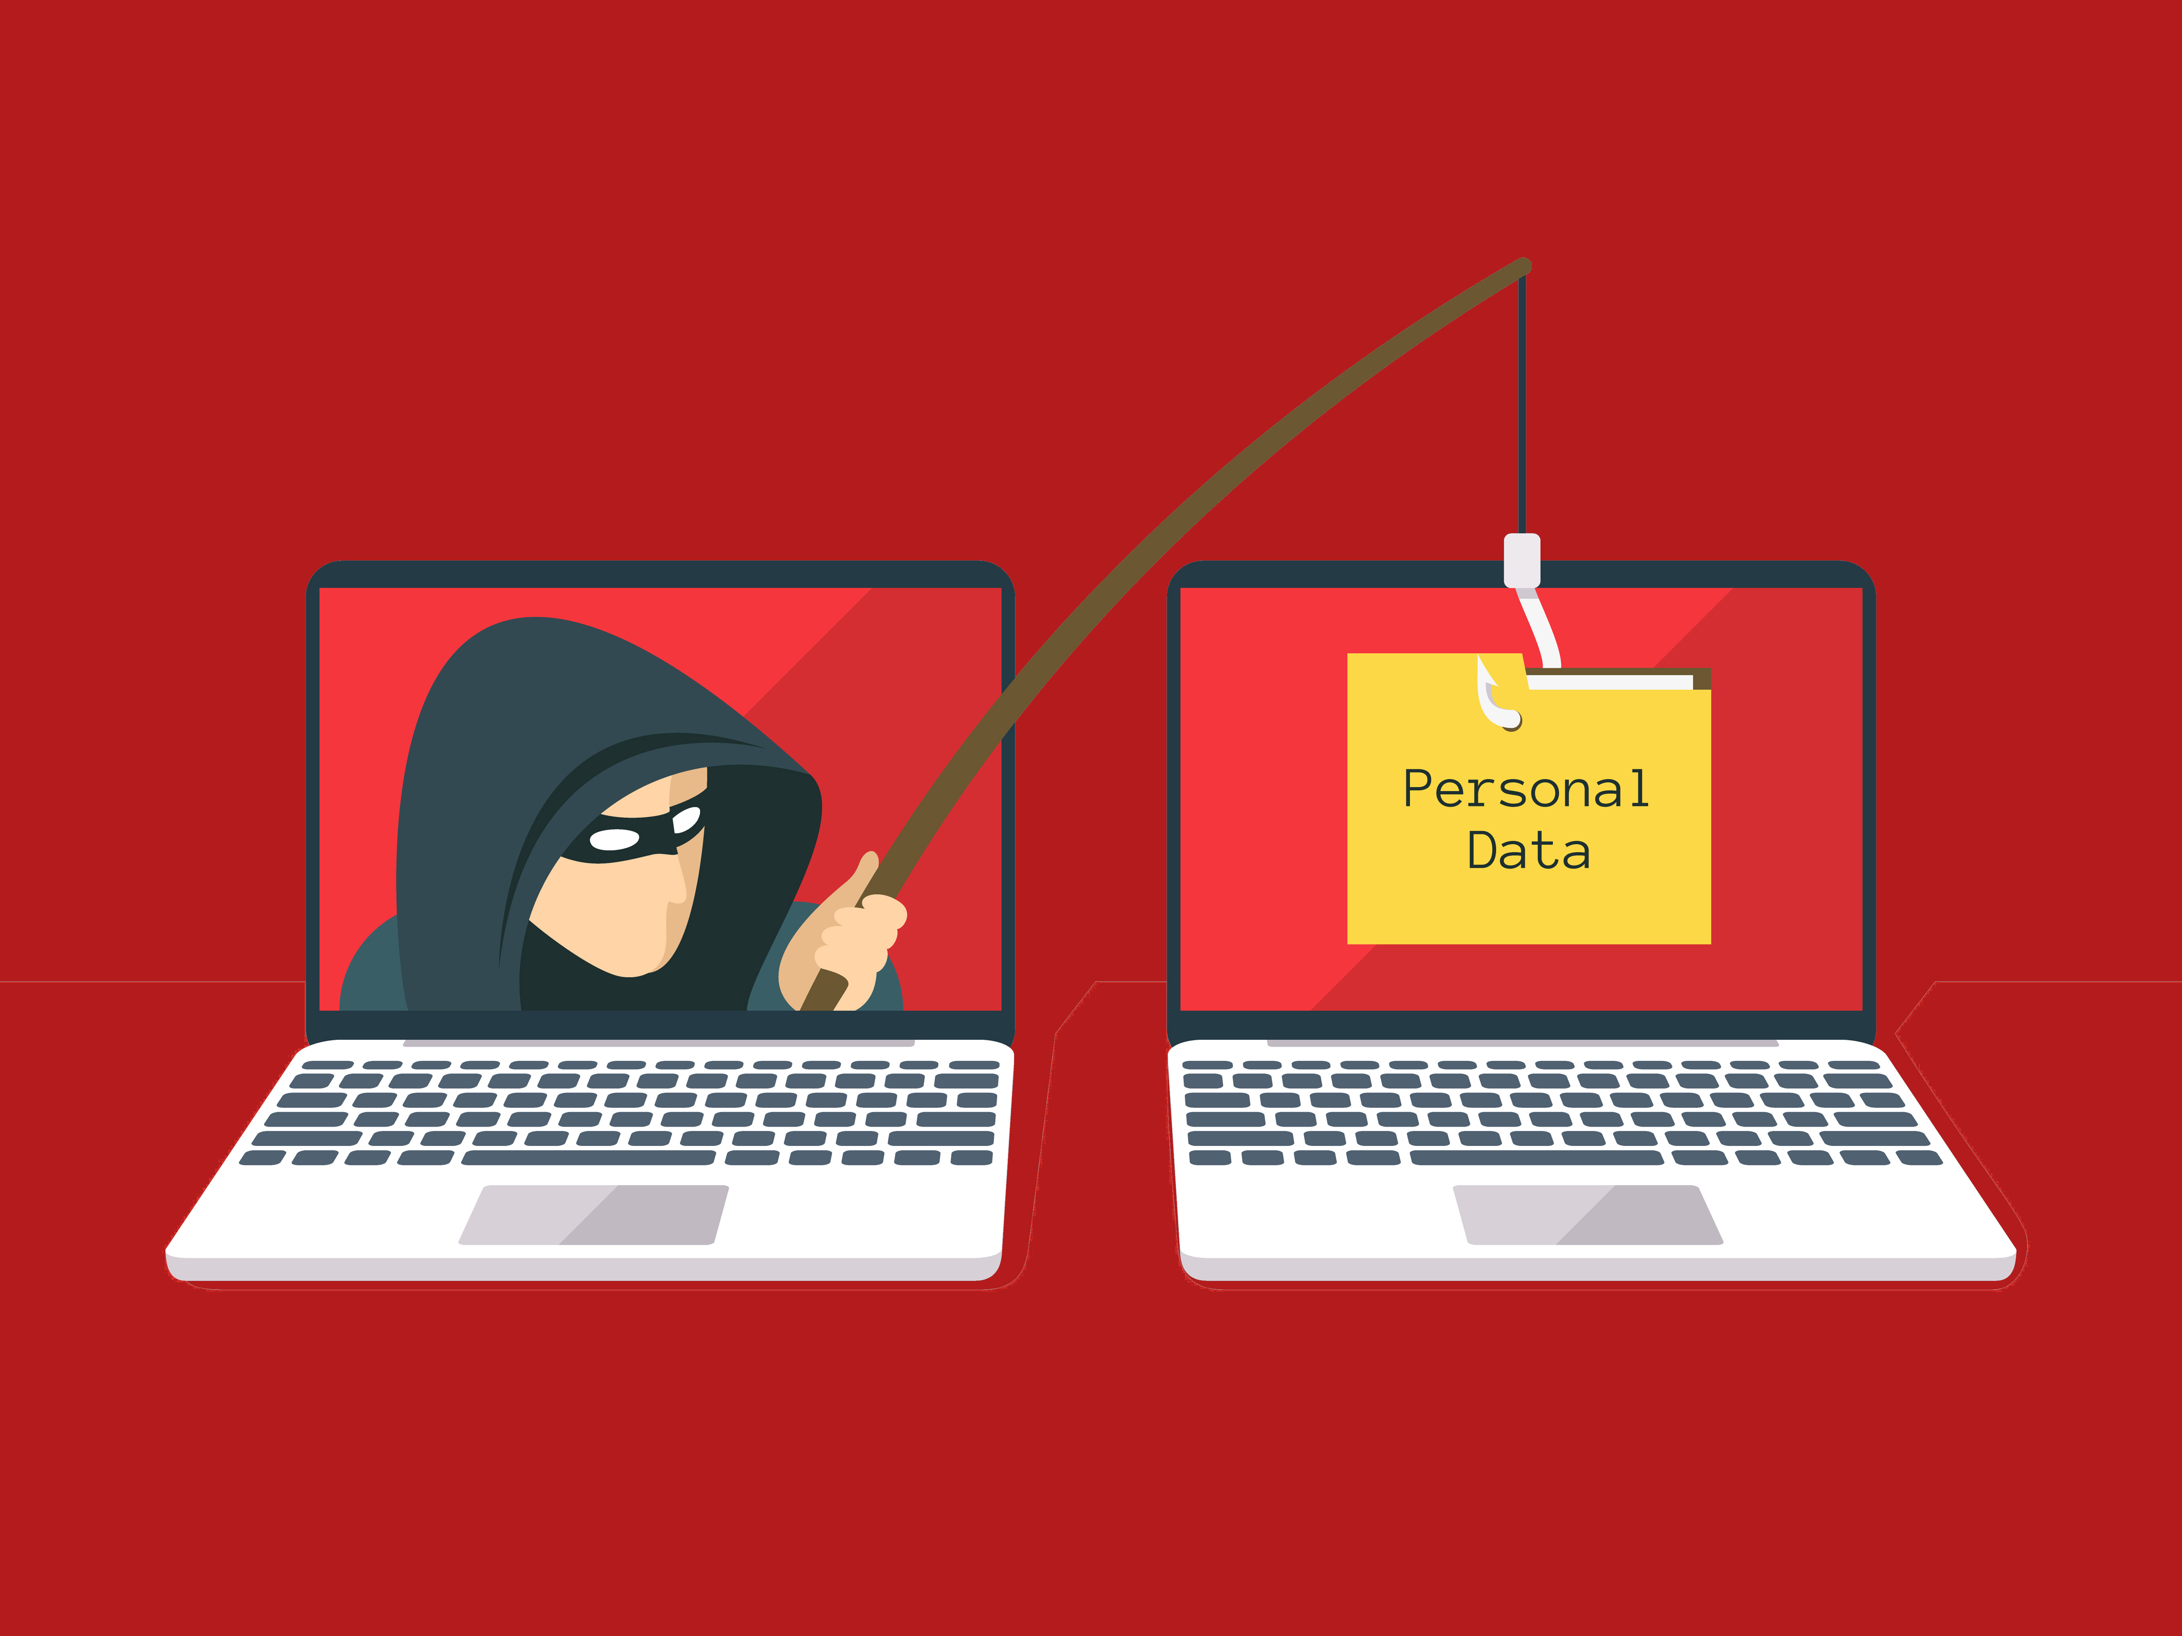
Hook, line and sinker
Understanding the security training needs of staff through phishing simulations.

Slide 2
What’s the issue?
How do we effectively identify security knowledge gaps among CCE staff
What can we do to close those gaps?
Goals of our phishing program:
Minimize risk and exposure
Protect critical data
Develop a digitally literate workforce

Slide 3
CCE : a broadly distributed system
Cornell Cooperative Extension:
56 independent 501c3 organizations affiliated with Cornell University
Campus based Central Administration
Admin can advise and recommend

Slide 4
CCE : a broadly distributed system
Cornell University
Land Grant institution for New York State
Cornell IT – Campus wide IT department
Sets policies which have implications for Associations
NYS County law 224
Establishes Cornell University oversight
CCE Shared Business Networks
Provide higher level HR, Finance and IT support on a regional level

Slide 5
CCE : the computing environment
Diverse
Pretty sure the last 486’s have been retired.
Standardization is a dream
Mobile and IoT provide exciting security challenges

Slide 6
Security in a broadly distributed system
Constantly changing needs and requirements
Same as its ever been…
New devices and technologies bring new challenges
Some days – the impossible dream

Slide 7
Not a product
Security is a process
You cannot buy ‘security’ off the shelf. But it is possible to teach people secure behaviors and security awareness.

Slide 8
Holistic security?
Our approach to security awareness and training:
Learning about security has value and impacts beyond the workplace
We all engage in behaviors meant to increase our security
It is a continuous process

Slide 9
Why Focus on Phishing?
Email is pervasive and vulnerable to social engineering
Good tools exist to simulate phishes
Phish spotting behaviors can carry over to other security realms

Slide 10
Phishline
Cornell University selected PhishLine as primary tool
CCE was invited to participate in piloting the process
Security testing, awareness and education

Slide 11
Rules of Engagement
Advance notice of a campaign to staff
Confidentiality in handling of data
A balance between reporting results and privacy
Data gathered for
Identification of exposure and knowledge gaps
Development of education

Slide 12
Pilot Campaign
3 fake phishes sent to 1,575 addresses. December 2017
1 additional phish sent February 2018
Designed to evaluate our systems awareness of, and response to, common phishing schemes
Click-Thru Behavior (3 campaigns, 1 of which sought out user credentials)

Slide 13
Communicating the plan
Communicating our intent was a priority
2 weeks prior to the kickoff notification was sent via email

Slide 14
First phish
Sent early December, 2017
29% click rate for this phish
Established our baseline

Slide 15
Last phish of first series
Cornell branded phish
Directed users to a ‘secure’ login page before passing them to a landing page with information
9.5% (198) of our users clicked through- supplying login credentials

Slide 16
Reporting results
Initial evidence seems to indicate an increased awareness, system-wide, of phishing
However, 1 of 10 employees engaged with the 4th fake phish
A need for intentional, system-wide, education was revealed

Slide 17
Identifying need
Overall picture of system indicating percentage of users who clicked on one or more phishes

Slide 18
Repeat offenders
Some users seem to have a compulsion to click
Over the course of 4 separate simulations 3 users clicked on each one
.2% of our users
4% engaged with 3 of the 4 simulations

Slide 19
Developing an educational program
Online course integrating 4 short training videos with quizzes
Soft release of the course
121 users completed course as of June 12 (course was opened May 14)

Slide 20
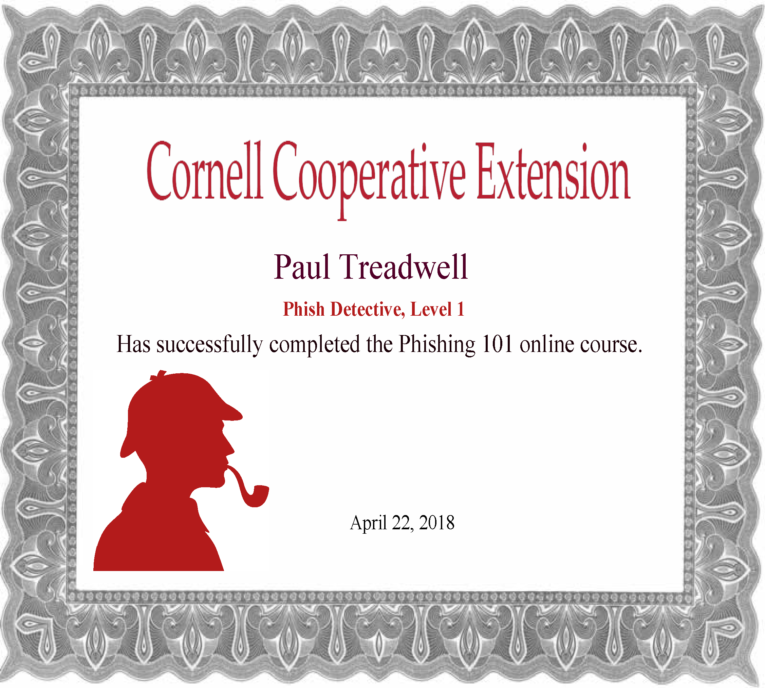
Engaging users in learning
Phishline customized 4 short phish detection training videos for Cornell
Successful completion of course = Phish Detective, Level 1 certificate
‘Gamification’ elements integrated in course

Slide 21
Evaluating the online course
I felt the Phishing 101 0nline course was useful:
Initial evaluation of the Phishing 101 online course:
89% rated course useful
86% feel more prepared to spot phishing emails now
83% would recommend the course to others

Slide 22
6 Months of Phish
Kicked off May 2018
Will target specific subsets of our user base
Data gathered will be used to develop further training

Slide 23
What’s next
Continued development of security focused education in the face of evolving threats
Expanding security trainings system wide, beyond phishing
Plenty to do – it’s job security

Slide 24
Resources
One Phish, Two Phish, How to Avoid the Internet Phish: Analysis of Training Strategies to Detect Phishing Emails - Olga A. Zielinska, et al. Proceedings of the Human Factors and Ergonomics Society Annual Meeting Vol 58, Issue 1, pp. 1466 – 1470. First Published October 17, 2014
Best Practices for Protecting Against Phishing, Ransomware and Email Fraud - http://bit.ly/2JGH9pw
PhishLine - https://www.phishline.com/

Slide 25
Contact Info
Paul Treadwell
pt36@cornell.edu
@ptreadwell

