Slide 1
NAVIGATING THE CHALLENGES OF DIGITAL ACCESSIBILITY
…in Extension and Outreach
Presented by:
Jed Findlay | Marketing
Kristi Elmore | IT
Rachel Tendall | Marketing
Robin Ertz | Professional Development
Notes:
Kristi Introduction of presentation–
Everyone introduces themselves
NOTE: Make note that they can ask questions at any time and brief outline/timeframe for parts of the presentation for those that want/need to sneak out for other presentations.

Slide 2
Who We Are
Not in dedicated accessibility roles
From different ISU Extension and Outreach departments
Leading the cause across the University
Leading across the state
Notes:
Kristi –
We are from several different departments throughout Extension and Outreach and none of us actually have digital accessibility as one of our job responsibilities. At Iowa State University, we are leading digital accessibility efforts and have made the most progress towards compliance, and as we’ve found out during some of our initiatives, we are actually leading the cause across the state!

Slide 3
Why We Are Here
We saw a need to fill
We believe in inclusivity
Compliance is the reality
To bring the research of ISU to ALL people of Iowa
Notes:
Robin
Why us? (which is something we've already been asked by a few in our organization)
Because members of this group saw a need to fill organization wide and we strongly believe in inclusivity, we all chose to add this to our plates. We know that not only is it the right thing to do to make our material available to all, but it is the law. We realize we are taking risks in these leadership roles, and we know things won't always go smoothly, but not trying is not an option.
We want to share our experiences and lessons learned along way in hopes that it will spark some level of interest, or resonate with someone, as to what you can try now. Baby steps are important!

Slide 4
Overview
Digital Accessibility is the ability of a website,
mobile application or electronic document to be easily
navigated and understood by a wide range of users,
including those users who have visual, auditory,
motor or cognitive issues.
Notes:
Kristi
**REFERENCE THE "ACCESSIBILITY IS A CIVIL RIGHT" DOC (https://iastate.app.box.com/file/278376982736)

Slide 5
Policy
Board of Regents Policy
To ensure equal access, as well as compliance with applicable local, state, and federal laws, the Regents universities and schools shall have policies and guidelines that demonstrate and support our commitment to electronic and information technology accessibility, including but not limited to, the following:
Guidelines for the procurement (e.g., Request for Proposal, contractual language), design and development, management and use of accessible electronic and information technologies.
Establishment of technical standards for accessible on-site and online learning and work environments.
Accessible web sites (e.g., Web Content Accessibility Guidelines)
Accessible document and media types
Campus awareness programs and support services.
No University Policy
Notes:
Robin
Unfortunately, with change, comes pushback. Since there is no official Iowa State University policy in regards to digital accessibility, we are moving forward under the policy guidance from the ADA of 1990 and the Iowa Board of Regents to ensure equal access – specifically the last 3 bullet points, (accessible web sites, accessible document and media types, and campus awareness programs and support services).

Slide 6
Universal Design Taskforce
First Meeting October 2016
Created as a way to let leadership team know where Extension & Outreach is at and what needs attention
Progress as of November 2017
Notes:
Share Document – Robin
Administration requested our Diversity and Inclusion Officer create a Universal Design Taskforce to evaluate the status of digital work in relation to accessibility. Members on the taskforce represent IT, professional development, video, and the office of diversity and inclusion. This helps to serve as an "official baseline" in more assertive initiatives and work.
Share status as of November 2017

Slide 7
The Parts and Pieces of Digital Accessibility
Websites
Closed Captions, Audio Descriptions and Transcripts
Digital Assets
Publications
PDFs
Powerpoints
Interactive Web Pieces, etc.
Webinars/Live Events
Notes:
Kristi -
So in order for us to be truly compliant and best serve ALL of our clients, ALL of our digital content needs to be accessible by those with visual and auditory impairments. And it needs to be able to be consumed with the same sort of experience as those without impairments.
We are going to give a brief overview on each of the areas that we’ve identified, explaining how each of us is addressing accessibility in these spaces. The topics have varying information because we are at different stages of the process for each topic. I'll talk about websites, Jed will discuss closed captions, Rachel will discuss digital assets and Robin will cover Webinars and Live Events.

Slide 8
Websites
Image alternate tags
Notes:
Kristi -
We’ve made a lot of changes to our newer sites (anything built within the last 3 years). This includes new theme development built accessible from the ground up, required image alternate tags and required training for web editors that includes many accessibility points.
As we continue to transition sites to this more accessible version, we’ve also begun work on training and information related to the additional resources added to websites – like making sure all videos uploaded have captioning and that all documents uploaded are accessible. This is still somewhat in the beginning stages and work will progress as we move forward.

Slide 9
Websites
Training for web editors
Notes:
Kristi -
We’ve made a lot of changes to our newer sites (anything built within the last 3 years). This includes new theme development built accessible from the ground up, required image alternate tags and required training for web editors that includes many accessibility points.
As we continue to transition sites to this more accessible version, we’ve also begun work on training and information related to the additional resources added to websites – like making sure all videos uploaded have captioning and that all documents uploaded are accessible. This is still somewhat in the beginning stages and work will progress as we move forward.

Slide 10
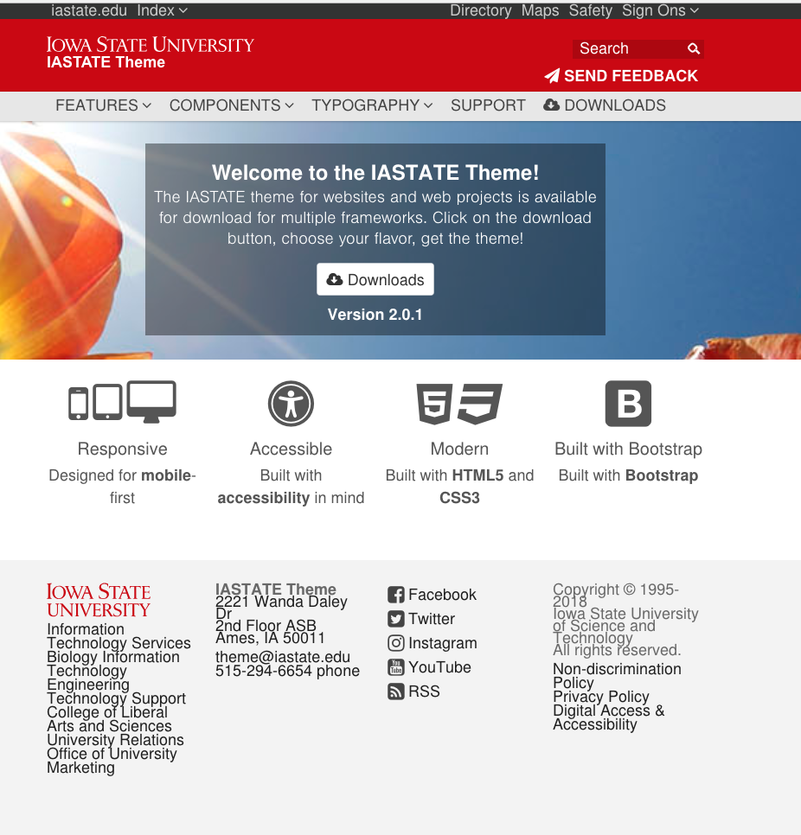
Websites
Themes are compliant
Notes:
Kristi -
We’ve made a lot of changes to our newer sites (anything built within the last 3 years). This includes new theme development built accessible from the ground up, required image alternate tags and required training for web editors that includes many accessibility points.
As we continue to transition sites to this more accessible version, we’ve also begun work on training and information related to the additional resources added to websites – like making sure all videos uploaded have captioning and that all documents uploaded are accessible. This is still somewhat in the beginning stages and work will progress as we move forward.

Slide 11
Websites
Working on added resources (Videos and Documents)
Notes:
Kristi -
We’ve made a lot of changes to our newer sites (anything built within the last 3 years). This includes new theme development built accessible from the ground up, required image alternate tags and required training for web editors that includes many accessibility points.
As we continue to transition sites to this more accessible version, we’ve also begun work on training and information related to the additional resources added to websites – like making sure all videos uploaded have captioning and that all documents uploaded are accessible. This is still somewhat in the beginning stages and work will progress as we move forward.

Slide 12
Closed Captions, Audio Descriptions and Transcripts
Notes:
Jed -
Reference Kristi's video that demos lack of accessible video content....Kristi sending Jed link

Slide 13
Closed Captions Defined
Closed captioning (CC)
process of displaying text on a television, video screen, or other visual display to transcribe or translate the dialogue, sound effects, relevant musical cues, and other relevant audio information. Other uses have been to provide a textual alternative language translation of a presentation's primary audio language.
Notes:
Jed

Slide 14
Video Descriptions Defined
Video Descriptions (or Audio Descriptions)
Video description makes videos accessible for people who are blind or visually impaired.
Short verbal descriptions of action or key visual scenes in a program, such as the setting, costumes, and facial expressions, are provided to add context. The descriptions are inserted into pauses within a program's dialogue.
Notes:
Jed

Slide 15
Video Descriptions Defined
Video Descriptions (or Audio Descriptions)
SAP (Secondary Audio Program) is auxiliary audio channel for analog television that can be broadcast or transmitted both over-the-air and by cable television.
SAP support is limited but on the rise for over the air HD, cable and other TV platforms.
Notes:
Jed

Slide 16
Audio Transcripts Defined
Audio Transcripts
Audio transcripts provides a text of a program for people who are deaf or hearing impaired.
Audio transcripts are used to make audio podcasts accessible.
Transcripts should include all elements of audio in the program.
Dialogue/Narration
Atmospherics
Notes:
Jed

Slide 17
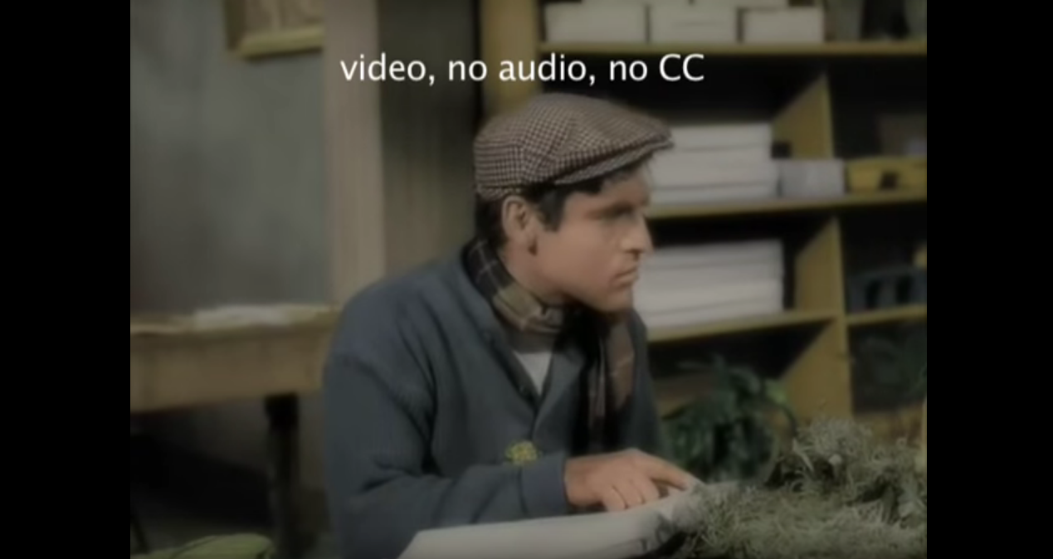
Closed Captions and Video Descriptions
Demonstrate Closed Captions and
Video Descriptions
Video
Notes:
Jed

Slide 18
Digital Accessibility in Video
Captions for all archived video online
Catalog what video we have online
Investigate a process to begin captioning
Pay an outside company
Caption ourselves
Notes:
Jed

Slide 19
Digital Accessibility in Video
Integrate captions into our video production workflow
Learn how to integrate captions into my workflow
Educate staff on integrating captions into their workflow
Demonstration of how we caption videos
Notes:
Jed

Slide 20
Generate vs. Auto-Generate
Generate
Using a tool to type the captions in yourself
Video editor
FCP
Premiere
Online platform
YouTube
Facebook
Notes:
Jed

Slide 21
Generate vs. Auto-Generate
Auto-Generate
Using a tool to automatically generate captions
Paid online companies
Rev.com
Online platform
YouTube
Facebook
Notes:
Jed

Slide 22
Generate vs. Auto-Generate
Auto-Generated captions MUST BE EDITED!
Notes:
Jed

Slide 23
Generate vs. Auto-Generate
Auto-Generated Must Be Edited
Accuracy
Capitalization
Punctuation
Atmospherics
Sound effects
Music cues
Notes:
Jed

Slide 24
Accessible Platforms for Video
YouTube
Auto-generated captions
Caption editing
Can export .srt (SubRip Text)
Can import caption files
No video descriptions/SAP
Notes:
Jed

Slide 25
Accessible Platforms for Video
Facebook
Auto-generated captions
Caption editing
Can import caption files
No video descriptions/SAP
Notes:
Jed

Slide 26
Accessible Platforms for Video
Vimeo
No auto-generated captions
No caption editing
Can import caption files
No video descriptions/SAP
Notes:
Jed

Slide 27
Accessible Platforms for Video
Twitter
No Auto-generated captions
No caption editing
Cannot import caption files
No video descriptions/SAP
Burn in ONLY
Notes:
Jed

Slide 28
Accessible Platforms for Video
Instagram
No Auto-generated captions
No caption editing
Cannot import caption files
No video descriptions/SAP
Burn in ONLY
Notes:
Jed

Slide 29
Accessible Platforms for Video
Snapchat
No Auto-generated captions
No caption editing
Cannot import caption files
No video descriptions/SAP
Burn in ONLY
Notes:
Jed

Slide 30
Captions in Video Editors
Final Cut Pro X
Can generate captions
Type in
Import transcript or captions file
Embed in file as closed caption
Burn in captions
Burn in SAP
Notes:
Jed

Slide 31
Captions in Video Editors
Adobe Premiere
Can generate captions
Type in
Import transcript or captions file
Export "side car" caption file
Export embed in Quicktime file
Burn in captions
Burn in SAP
Notes:
Jed

Slide 32
Captions in Video Editors
Camtasia
Can auto-generate captions
Accuracy is very low
Can edit
Notes:
Jed

Slide 33
Using Canvas LMS
Iowa State University uses Canvas
ARC is used to caption
Integrated into our workflow
Offers very good auto-generated captions
Capitalization
Punctuation
Notes:
Jed

Slide 34
Digital Assets
What are we covering here?
All digitally-distributed documents
Not consumed as standard web content
Not video or audio
Can be downloaded
Notes:
Rachel
**REFERENCE THE ”Publication Toolkit”

Slide 35
Digital Assets
This would include:
PDF
Word
Powerpoint
Publisher
InDesign Exports
And More
Notes:
Rachel
**REFERENCE THE ”Publication Toolkit”

Slide 36
Many Moving Parts and Pieces
To make it even more complex:
Different Document Purposes
Different Screen Readers
Different Types of Impairments
Notes:
Rachel
NVDA, JAWs, VoiceOver for Apple
Low-vision vs no-vision vs color-blindness

Slide 37
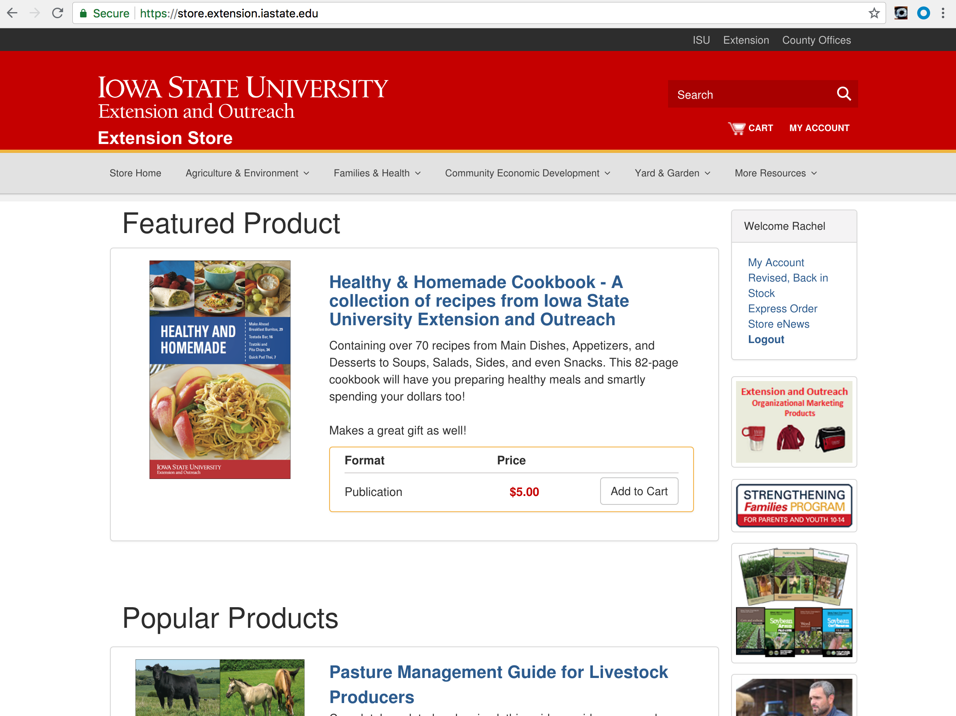
How We Are Breaking It Down
Publications on Store
PDFs from InDesign
PDFs from Acrobat Pro
All other supporting documents on Websites
PDFs from Microsoft Office Files
Microsoft Office Native Files
Notes:
Rachel

Slide 38
Acrobat Pro for Accessibility
Best tool, but still not easy:
Accessibility Checker Report
Tagging
Recognize Scanned Text and Images
Bookmarks
Hyperlinks
Notes:
Rachel

Slide 39
InDesign for Accessibility
Making strides but not all the way there:
Document Title and Language
Styles Mapping to Tags
Image Alt Text
Soft Returns
Some Reading Order Structure
Notes:
Rachel
**REFERENCE THE ”Publication Toolkit”

Slide 40
Microsoft Office for Accessibility
Easy, but not necessarily accurate:
Accessibility Checker, simplified
Image Alt Text
Hyperlinks
Standardized Styles
Notes:
Rachel
**REFERENCE THE ”Publication Toolkit”

Slide 41
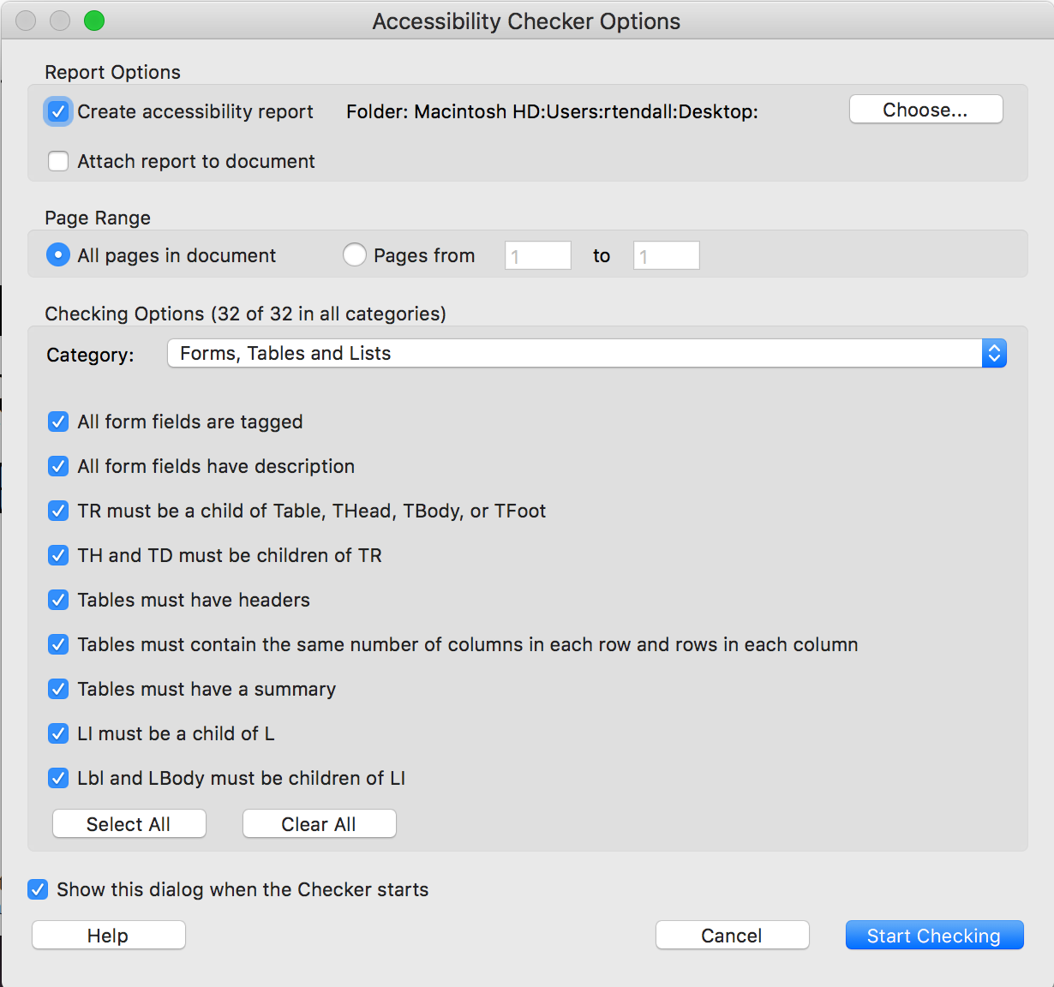
Accessibility Checkers
Our Recommendation:
Acrobat Pro Accessibility Checker
Other Options:
Microsoft Office Checkers
Axes PDF
Pave PDF Checker
Notes:
Rachel
**REFERENCE THE ”Publication Toolkit”

Slide 42
Webinars/Live Events
Live events captioned by Caption Colorado
Post captioning by Caption Sync
Pass through costs
Notes:
Robin

Slide 43
Professional Development
3 tier approach
Direct contributing publication editors (20) - including 2 dedicated PDF remediation workers
Remediation and new documents
Web content editors (500)
All of ISU Extension & Outreach (1150)
Notes:
Robin
Core members of our team received training (as a TTT thing) from an external vendor. This training was done completely online and covered PDF document remediation strategies and the work flow process for creating new documents. It mainly focused on InDesign and Acrobat Pro. Team members are learning about incorporating accessibility strategies into InDesign, Acrobat Pro, MS Office, and will be learning how to use JAWS screenreader. We chose JAWS, because
As you can see, a lot of work is being done in support roles by support staff, but what about changing mindsets and work process flows organization wide?
Upon request, we provided a 2 hour information session for Extension & Outreach faculty and staff during their April Professional Development day. The session was so well received that we will be extending the invitation to other program areas to invite us in for a similar presentation.
3 tier approach – for meeting group/role needs and for us to be able to scaffold the opportunities.
Direct contributing publishing editors (InDesign, Acrobat DC, Axes PDF, JAWS) - there are about 2,500 existing publications with just over 25,000 pages to remediate – this is where we're at right now
Web content editors (Drupal, MS Office, JAWS)
All others throughout the organization (MS Office, JAWS)
Opportunities will be provided in various formats: face-to-face (hands on), webinars, a Moodle course site, Q&A sessions, external sources, pre-recorded presentations, handout documents with step by step information, and the Accessibility is a Civil Right

Slide 44
Video Captions Demo
Closed Captions Workflow
FREE
Use YouTube
Auto-generate captions
Edit captions
Export .srt file
Name .srt file
Import .srt to other platforms
Notes:
Jed

Slide 45
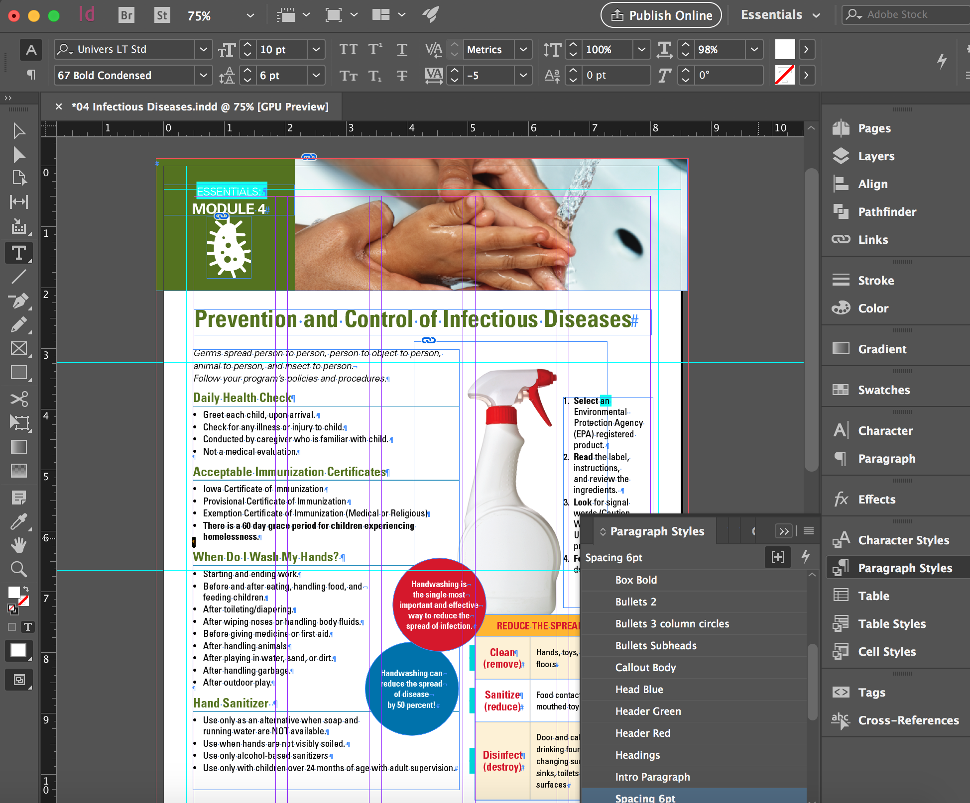
InDesign & Acrobat Pro Demo
Screen Reader Example
Accessibility Checker
Editing in Acrobat Pro
Tagging Necessary?
Planning for Accessibility in InDesign
Document Properties
Image Alt Tags
Paragraph Styles
Reading Order
Soft Returns
Notes:
Rachel
So as our team reviews the accessibility of our digital publications on the Store, we are finding that the process of creating accessible PDFs is a blended process where both steps in InDesign and Acrobat Pro are necessary. In order to develop a process, we had to establish a common measuring stick for success. We knew we needed to follow the WCAG 2.0 Standards, and, more specifically, PDF/UA standards. As we were researching accessibility checkers, we kept coming back to Acrobat Pro's checker. There were comparable tools on the market, as I mentioned earlier, but the detail of Acrobat Pro's checker coupled with the editing tools already built in made it our preferred measuring stick. And our organization has an enterprise subscription to the Adobe Creative Cloud, so we could use this software at no additional expense.
So how does the Adobe Accessibility Checker work? This is a good time for me to mention that we are still learning, so, if you know more than we do, feel free to jump in. We can share what we have learned so far.
Opened in Acrobat Pro, I have one of our Store publications available for download. To access the Acrobat Pro Accessibility Checker, select "Tools" and locate the "Accessibility" button. When you want to run a full check on a PDF, select "Full Check". Make sure that all 32 sections are selected for review. You will develop a full HTML Report which will also be summarized in the left-hand panel on Acrobat Pro. This HTML report is what we are now requiring our designers to submit with their PDF publications before they will be uploaded on the Store – the measuring stick. The report follows the WCAG standards.
Any failed reports will need to be modified. As you click through the summary report, you can select "Explain" for any of these sections and notes on how to address the issues will appear.
Walk through editing...
After all of the edits are made, run the full check again for a passed report. This along with the updated file are sent to our Store. So, are we done now?
No...This is where things get tricky. It all comes down to Tagging...
Video of screen reader: https://www.youtube.com/watch?v=GaNwnsT4B5s
Tagging affects:
Reading order and continuation
Tab order
Image information
Table structure
Document Title and Language, and more
Demonstrate...
You can see this is quite cumbersome, and each time you were to make edits to the art file down the road, you would have to redo all of this work EVERY TIME. So how can we automate some of this in InDesign? Some of this can happen to the original file...
Document Properties
Image Alt Tags
Paragraph Styles
Reading Order
Soft Returns
Are all things that can be done in the original file to simplify your work in Acrobat down the road...
Lets go to the InDesign file:
Before we do anything, we need to set our Export settings to include our accessibility features. If you are familiar with InDesign, you probably know you have different attributes required for a Print PDF versus an Interactive PDF. An accessible PDF is no different.
Demonstrate:
Now you can work on including the accessible features. Lets first set document settings:
Demonstrate:
Lets also set our Image alt tags:
Demonstrate:
Who uses paragraph styles? Maybe you use these to simplify your design process on large documents? Well, for accessibility-purposes, they are now critical to your tagging work flow. Use them! How you use these will influence the tags they receive in Acrobat, and can even make your tab order set up a breeze. After you have designed with paragraph styles, you can link them to tags like H1, H2, H3, P, etc.
Demonstrate:
To assist in the reading order of content, watch your layers. Layers will read in order of bottom to top.
Demonstrate:

Slide 46
Lessons Learned
Digital Accessibility is HARD AND COMPLEX.
Tools are improving, work is getting easier
Progress is progress!
Hire full-time help, not only students
Start with leadership buy-in
Integrate in workflow, not just at end
Communication and collaboration with all involved is KEY!
Notes:
Robin

Slide 47
What’s Next for Us
Educating staff on process & tools to integrate digital accessibility into their workflow.
Video descriptions
Building websites accessible from the ground up
Digital Universal Design Compliance Initiative: Remediating all public-facing PDF Publications
Notes:
Robin

Slide 48
What’s Next for You
Even if you do not have dedicated staff or funding, you can still make progress
Small steps matter
Buy in from stake-holders (not necessarily funding), but support
Notes:
Kristi

Slide 49
Resources and Reminders
Accessibility in ISU Extension & Outreach (November, 2017)
Publication Toolkit (Pilot Phase)
Digital Accessibility Handout
Notes:
Kristi

Slide 50
Thank You
Jed Findlay [Marketing] jfindlay@iastate.edu
Kristi Elmore [IT] kelmore@iastate.edu
Rachel Tendall [Marketing] rtendall@iastate.edu
Robin Ertz [Professional Development] rbrekke@iastate.edu

