Slide 1
Using Virtual Reality to Expand Opportunities for Rural Students
Mark Light: The Ohio State University
light.42@osu.edu

Slide 2
What we want to do today
Explore how VR can be used in with youth and Extension clinetele
2. Share resources, strategies and approaches to using VR

Slide 3
China's VR market will be $8.5 Billion in 2019 and there are at least 200 startups working in China’s VR industry including hardware and software.
$8.5 Billion
100 million
VR units shipped in United States last year
96%
Percentage of goggles shipped in the United States: Google Cardboard
2020
The virtual reality market will be worth 15 times what it was in 2016.

Slide 4
Growth is stemmed by
The growing integration of smartphones
2. The Internet of Things (IoT) revolution.
3. Head-Mounted Displays (HMDs) - wired and wireless variants
smart glasses and cardboard cases.
Gesture tracking devices include gloves, haptics, treadmills, body units, hand device, and foot controls, and wearable cameras.
5. Software diversity – apps, youtube, TV programming

Slide 5
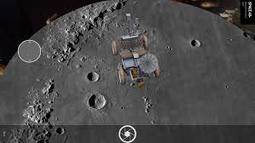
Project Overview
We are moving away from simply “learning” about a time or place to “feeling” the content.
Virtual Reality can bridge the “opportunity gap” experienced by underserved youth by taking them beyond the boundaries of their local environment.
Virtual reality makes travel possible without the constraints of time and permission slips / liability / costs.

Slide 6
How we have integrated VR Technology into our work
STEAM on the QUAD
Tech Wizards
4-H Clubs
In School Programming

Slide 7
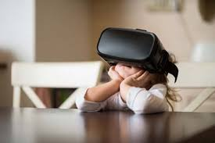
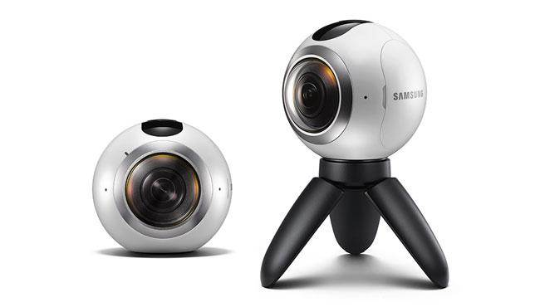

Slide 8
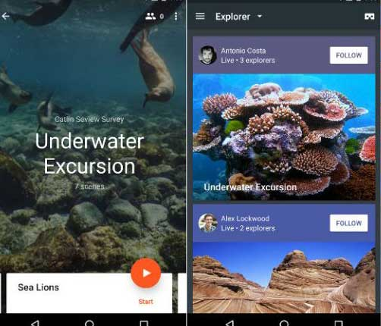
Expeditions
Expeditions is available under the Education category in Google’s Play Store, however, it’s more fun than education and people of all age groups can equally enjoy it. It allows users to experience the world’s popular destinations, places and go on expeditions.

Slide 9
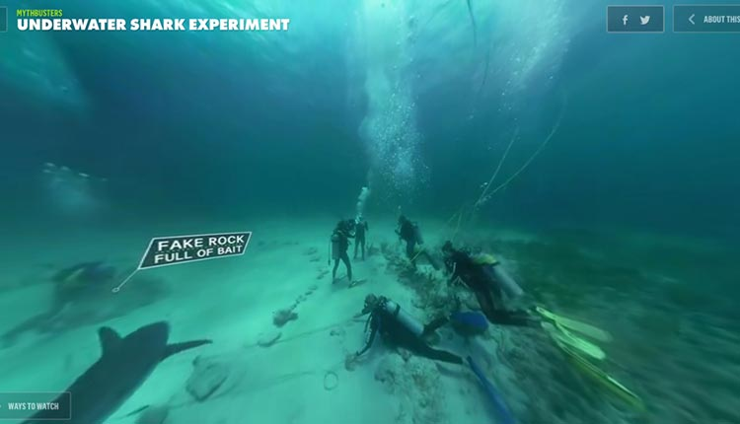
Discovery VR
No list covering the best VR apps would be complete without Discovery VR. It’s the official app from the Discovery Channel. Unfortunately, you cannot watch all of Discovery’s content on this app but it still has a lot of VR content you can enjoy.

Slide 10
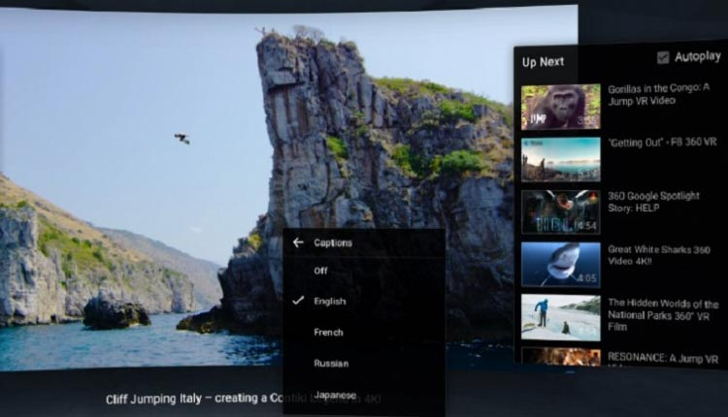
YouTube VR
Go Pro VR
YouTube is one of the best online resources to get your hands on 360-degree videos for free. Like other Google apps, YouTube VR is available for free too.

Slide 11
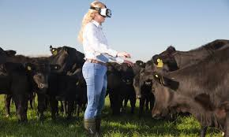
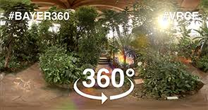
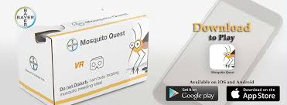
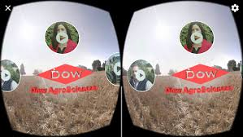
Agriculture

Slide 13
Time to Explore
Cardboard
Camera

Slide 14
Lessons
Personal phones, ipods, to recycled phones
Slow and steady
Limit persons in shots
Use a tripod
360 Video capture
Need a hosting place for content
Not everyone has access to VR google to view

Slide 15
Resources
Google Camera
Google Street View
http://www.instavr.co
http://virtualrealityforeducation.com/resources/

Slide 16
What are you doing with VR?
Other applications you would like to try ?
Mark Light: The Ohio State University
light.42@osu.edu

