Slide 1
Look Ma No Frameworks
Direct Coding of PDFS for Extension Applications
Or
How to Get rich by Using Other People’s money
Finished
Code

Slide 2
F is for FREE
FPDF - http://www.fpdf.org/
“is a PHP class which allows(sic) to generate PDF files with pure PHP”.
List- simple output of search results
Graphing – adding axes and plotting x,y coordinates
Forms- filling in tables with information from databases
Complex Documents- combining all of the above with headers, footers, and logic.

Slide 3
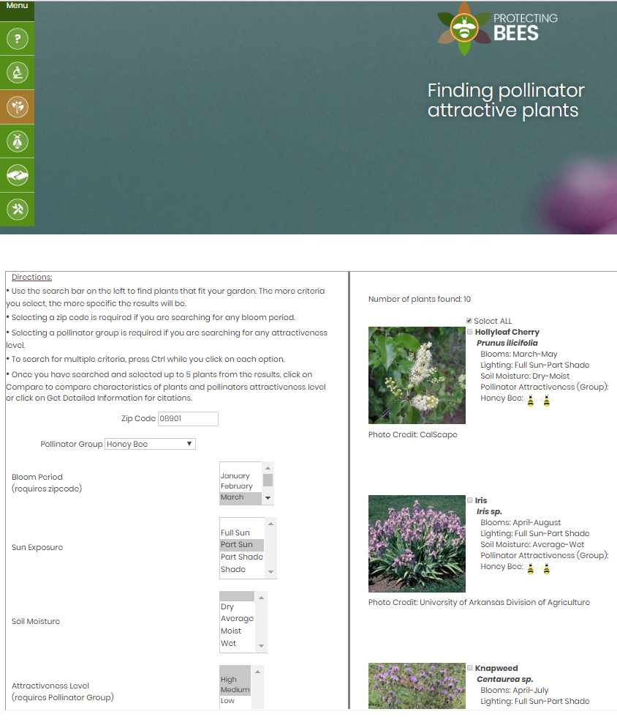
List
protectingbees.njaes.rutgers.edu

Slide 4
Protecting Bees
Under the hood
LAMP STACK- Linux Apache MariaDB(Mysql) PHP
Iframe within a WordPress site
2 scripts- 1 pdf script– 45 lines of code to create list
3 Data Input Screens- General Publication,Planting Information,Observations
Plants- External MSAccess Database via Bayercode

Slide 5
FPDF commands
General use: require(‘fpdf.php');
For transparency:require('alphapdf.php’);
START: $pdf = new FPDF();
In between: $pdf->Command();
END: $pdf->Output();
Standard Command: AddPage(), SetFont(), Cell(), Write();Ln();
Graphical: GetX(),GetY(),SetX(),SetY(),Image(),Line()

Slide 6
Protecting Bees select PDF code
1.$pdf=new PDF('P','mm',array(216,275));
2. $pdf->AddPage();
3. $pdf->Image($beeimage,10,10);
4. $pdf->Image($ir4image,185,10);
5. $pdf->SetY(15);
6. $pdf->AddFont('helvetica','');
7. $pdf->AddFont('helvetica','B');
8. $pdf->SetTextColor(0,102,0);
9. $pdf->SetFont('helvetica','B',28);
10. $pdf->Cell(20,0,'Protecting Bees',0,0,'L');

Slide 7
Protecting Bees select PDF code (cont.)
  1. for ($y=0;$y<sizeof($croplist);++$y){
  2. $pdf->Cell($buffer,0,($y+1).". ",0,0,'R’);
  3. $pdf->Write(0,$croplist[$y]['CropCommonName']);
  4. $pdf->SetFont('helvetica','I',14);
  5. $pdf->Write(0," - ".$croplist[$y]['CropLatinName']);
6. $pdf->SetFont('helvetica','',14);
7. $pdf->Ln(5);}
  …
8. $pdf->Output($fullname,'F');

Slide 8
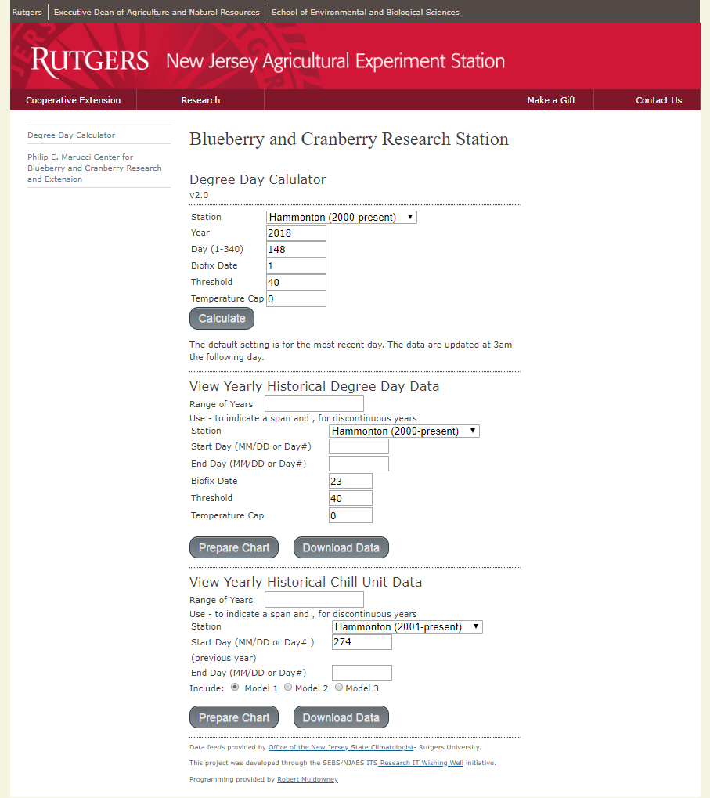
Graphing
benedick.rutgers.edu/Blueberryweather/

Slide 9
Degree Day Calculator
Under the hood
WIPP stack – Windows IIS PostgreSQL PHP
4 interactive scripts/2pdf – 90 lines for PDF
Combines field weather data with National Weather Service predictions.
Email notification of missing data

Slide 10
Degree Day Calculator select PDF code
1.$pdf=new PDF();
…
2. $color= array (
3. 0 => array("red"=>71,"green"=>133,"blue"=>184),
4. 1 => array("red"=>255,"green"=>81,"blue"=>81),
…
5. $scale=max($maxy)+0.05*max($maxy);
6. if ($scale<500){$ytmark=50;}
7. elseif ($scale<1000){$ytmark=100;}
…
8. if ($numdays<50){$xtmark=5;}

Slide 11
Degree Day Calculator select PDF code (cont.)
1. $pdf->SetLineWidth(1);
2. for ($j=0;$j<sizeof($yearlistfull);++$j){
3. $pdf->SetDrawColor($color[$j]['red'],$color[$j]['green'],$color[$j]['blue']);
…
4. $pdf->Cell(10,0,$yearlistfull[$j],0,0,'L’);
5. $labelx=$pdf->GetX();$labely=$pdf->GetY();
6. $pdf->line($labelx+5,$labely,$labelx+20,$labely);
…
7. $pdf->line($xcoord,$ycoord,$xcoord2,$ycoord2);
…
8. $pdf->Output('./Reports/temphist'.$tempnum.'.pdf',"F");

Slide 12
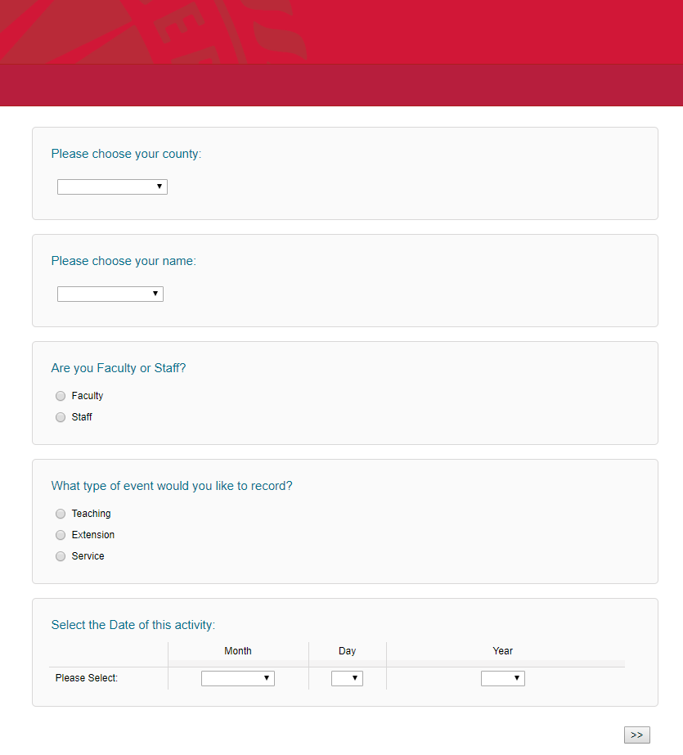
Forms

Slide 13
Extension Project Data Manager
Under the hood
WIPP stack – Windows IIS Postgresql PHP
Qualtrics Survey data collection with XML download
5 interactive scripts/2pdf- 800 lines to create each form
44 (1C)/20 (annual survey) form sections
Access controlled with central authentication system

Slide 14
Extension Project Data Manager select pre- code
4. Audio-Visual Media & Computer Materials Developed
Computer Software Program
 | Name | Description
 | Q87 (list) | Q88 (list)
Powerpoint
 | Authors | Title | # of Slides | Date Developed | Date Revised | % Development | % Content
 | Q91 (list) | Q92 (list) | Q93 (list) | Q228 (list) | Q229 (list) | Q94 (list) | Q94 (list)
Web based instructional program
 | Name | Description
 | Q89 (list) | Q90 (list)
Educational Exhibits
Activity | Amount | Contact Hours | Estimated Total Participants Reached
County Fair (Q261 if answered A) | 262 (sum) | 263 (sum) | 264 (sum)
Health Fair (Q261 if answered B)
Farmers Market(Q261 if answered C)
Other (list)

Slide 15
Extension Project Data Manager select PDF Code
1. //Draw Table 6
2. $pdf->SetFont('Verdana','B',12);
3. $pdf->Cell(0,5,"3. Curriculum/Program Developed",0,0,'L');
4. $pdf->Ln(10);
5. for ($x=0;$x<sizeof($table6_list);++$x){
6. $pdf->SetFont('Verdana','B',10);
7. $pdf->Write(5,$reportinfo[$table6_list[$x]]["q39"]);
8. $pdf->Ln(10);
9. $pdf->SetFont('Verdana','',9);
10. $pdf->Write(5,"The curriculum ".$reportinfo[$table6_list[$x]]["q40"]." (".$reportinfo[$table6_list[$x]]["q41_1"]."% idea, ".$reportinfo[$table6_list[$x]]["q41_2"]."% writing, ".$reportinfo[$table6_list[$x]]["q41_3"]."% research)");
$pdf->Ln(10);
}

Slide 16
Extension Project Data Manager select PDF Code (cont.)
1. $reportinfoflip=array_flip($reportinfo);
…
2. if ($reportinfoflip["q60"]!=NULL) {$q60=array_count_values($reportinfoflip["q60"]);}
3. if ($reportinfoflip["q242"]!=NULL) {$q242=array_count_values($reportinfoflip["q242"]);}
…
4. $pdf->Cell(0,5,"# of TV Programs Produced: ".$q60[17],0,0,'L’);
…
5. $pdf->Cell(0,5,"Less than 2 minutes: ".$q242[1],0,0,'L');

Slide 17
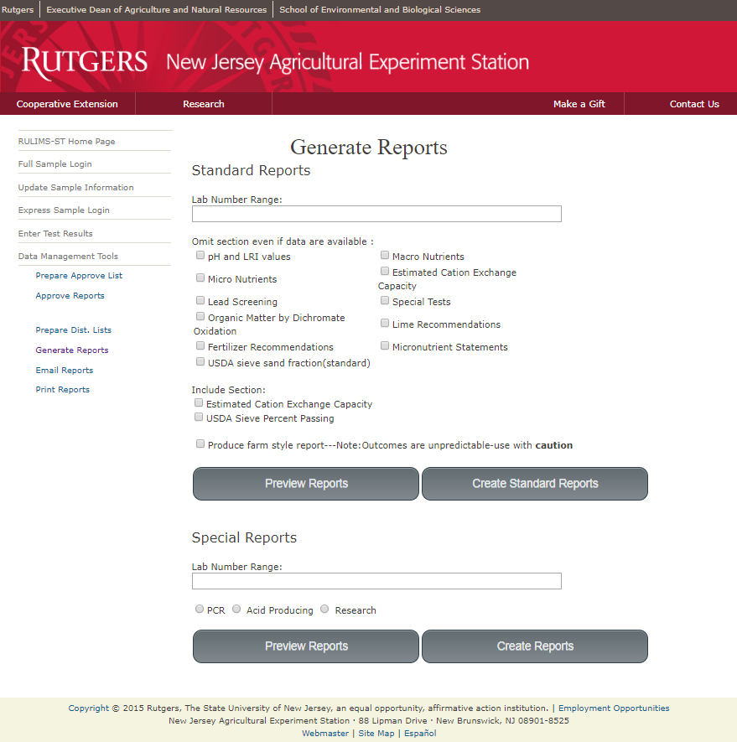
Complex Documents
benedick.rutgers.edu/RULIMS-ST5-DEMO/

Slide 18
RULIMS-ST V5.0
Under the hood
WIPP stack – Windows IIS PostgreSQL PHP
Version 1.0 – 2010 Version 6.0 – summer 2018
80 interactive scripts- 2 pdf scripts- 1800 pdf related
Uses school’s cascading style sheet (CSS)
Approx. 70000 samples reported to date

Slide 19
RULIMS-ST V5.0 select PDF Code
1.class PDF extends FPDF{
2. function Footer(){
3. $this->SetY(-15);
4. $this->SetFont('Arial','I',8);
5. global $displaynum;$sampleinfo[0]['battery'];
6. if ($sampleinfo[0]['sample_type']!='5'){
7. $this->Cell(0,10,'Soil Test Report for Lab # '.$displaynum.' Page '.$this->PageNo().'/{nb} RULIMS-ST V5.6 ',0,0,'C');
}
8. else {
$this->Cell(0,10,'Compost Test Report for Lab # '.$displaynum.' Page '.$this->PageNo().'/{nb} RULIMS-ST V5.6 ',0,0,'C');
}}}
9. $pdf=new PDF('P','mm',array(216,280));
10. $pdf->AliasNbPages();

Slide 20
RULIMS-ST V5.0 select PDF Code (cont.)
1. $ycoord=$pdf->GetY();
2. $pdf->Cell(15,5,$phlabel1,0,0,'L');
3. $phmark=($standardresults[0]['ph']-4)*30;
4. if ($phmark>120){$phmark=120;}
…
5. $pdf->line($phmark-2+45,$ycoord+2,$phmark+45,$ycoord+4);
6. $pdf->line($phmark+45,$ycoord+4,$phmark+2+45,$ycoord+2);
$phline1=($cropinfo[0]['phtarget']-5.5)*30;
…
7. $pdf->SetFillColor(255,0,0);
8. $pdf->Cell($phline1,4,'',0,0,'L',true)
9. $pdf->SetFillColor(255,255,0);
10. $pdf->Cell($phline2,4,'',0,0,'L',true);

Slide 21
Summary and Status
Diverse set of applications using FPDF
Plant-Pollinator Search engine- simple lists
will add noxious weed information to search results
Degree Day Calculator- color coded graphing
recently added data download
Extension Project Data Manager- automating forms with Qualtrics survey data
No updates currently planned
Laboratory Information Management System- complex multipage reports
Currently adding new features such as: Data removal and Data downloads

Slide 22
Acknowledgements
Collaborators
Protecting Bees Degree Day Calculator
Dr. Cristi Palmer Dr. Peter Oudemans
IR-4 Ornamental Horticulture Program Manager Professor – Dept. of Plant Biology and Pathology Yun-han Lan
Amy Abate
Extension Project Data Manager RULIMS-ST
Dr. Sara Elnakib Dr. Stephanie Murphy-Director
Extension Agent- Passaic County Stephen Griglak
Terriann DiLalo
Phyllis Breeman

Slide 23
Acknowledgements
Other People’s Code
FPDF- Olivier Plathey
PDF creation (all)
jQuery- John Resig
Autocomplete customer search (RULIMS-ST)
Tab switching for sample updates (RULIMS-ST)
Css3buttongenerator- Steven Wanderski
Submit Buttons (all)

Slide 24
Q & A
Contact- robert.muldowney@sebs.rutgers.edu

