Slide 1
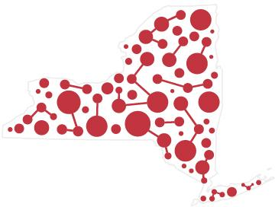

Slide 2
A New York State of (IT) Mind Cate Sirek, IT Lead Manager, Finger Lakes SBN Gale McArdell, IT Lead Manager, North/Central SBN
Notes:
My Name is Cate Sirek, and I’m the IT Lead Manager for the Finger Lakes Shared Business Network of Cornell Cooperative Extension in New York. And this is my colleague, coworker, and friend, Gale McArdell, the IT Lead Manager for the North/Central Shared Business Network of cornell Cooperative Extension.
I’ve been attending NETC for the past 5 years, this is my 4th, and I only missed one (In Florida). One of my favorite things about NETC has been the opportunity to talk to other Extension Tech professionals from across the country, to hear how Extension and in particular IT in Extension works for other states … we all do things very differently!! I thought it would be interesting to start a discussion about “How IT Works in Your State” to share and exchange ideas, learn best (and worst!) practices, and commisserate about the ups and downs of IT in our unique situations.

Slide 3
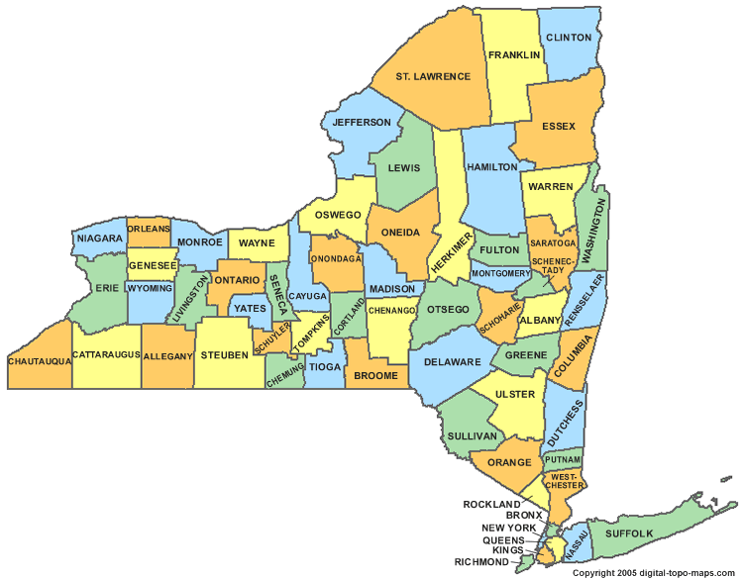
Notes:
One of the things that struck me was how very different NY runs CCE compared to other states.
There are 62 counties in NY, and 54 Cooperative Extension Associations. Each Association is a separate entity, and each hires and fires staff and has their own budget with funding coming from county, state, and federal (NIFA) dollars as well as grants and other resources. This is a very “grassroots” way of running Extension, as each county can drive their programming according to the needs of that county.

Slide 4
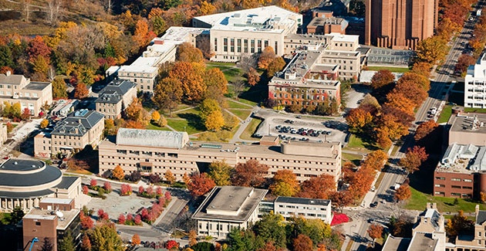
Notes:
So while we have these 54 separate entities, hiring and firing staff, determining their program needs, Association payroll is processed through Cornell University, and we also have many of the benefits of on-campus staff though we are all technically employed by our respective Associations.

Slide 5
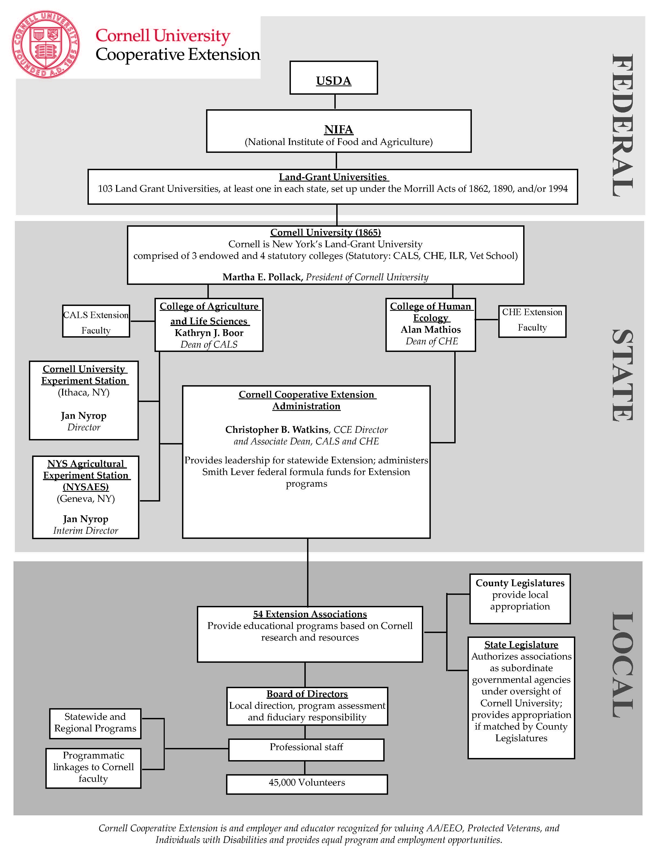
Notes:
So let’s look at the overall organization of CCE in NY –

Slide 6
Notes:
We start the same as other land-grant universities at the Federal level, … with funding from USDA through NIFA.

Slide 7
Notes:
At the state level, you can see that Cornell is NY’s land grant University because of 3 endowed and 4 statutory colleges, and CCE is most closely connected with the College of Ag and Life Sciences and the College of Human Ecology.
We have an Extension Director, Chris Watkins, who is also an associate Dean in each of those schools

Slide 8
Notes:
And this shows us the Campus Staff/Administrative end of CCE on campus. Director Watkins, Assistant directors,

Slide 9
Notes:
And this is the on-campus IT team (well, an earlier incarnation)…

Slide 10
Notes:
And here at the county level, you can see where we get a bit different. Most Association staff (including SBN staff)

Slide 11
Notes:
OK! So we’ve got out So we have these 64 counties out there, all doing their own thing and operating with some vague guidelines from Campus (HR and Finance are much more “regulated”). And around 2010, the idea of “Shared Business Networks” was born out of the thoughts, “while our programming varies widely, there are certain business functions that we all should be doing the same” and Campus Administration put out an RFP for proposals to consolidate into regions the business area functions of Finance, Human Resources, Information Technology. The program areas like 4-H/Youth Development, Agriculture, Family and Consumer Sciences, had already been working in some regional teams and were not included in this effort.

Slide 12
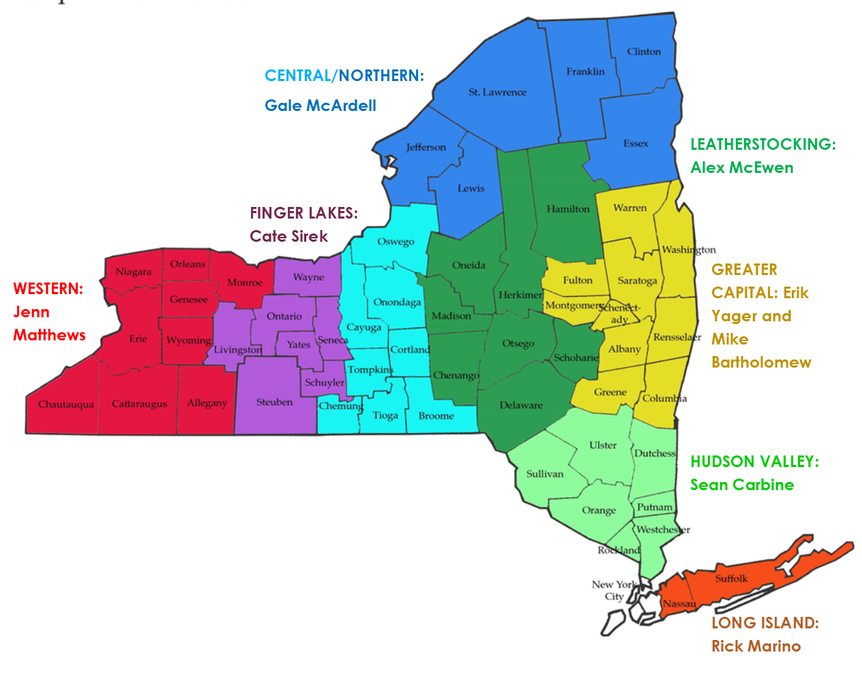
Notes:
So the idea for SBNs was initially implemented 2010-2013, and we ended up with 8 Regions or SBNs (Shared Business Networks), and each SBN has a Lead Executive director and leads in the HR, finance, and IT functional areas.
(From the “What is an SBN” document on the CCE Staff site).
Cornell Cooperative Extension Shared Business Networks Shared Business Networks (SBN’s) provide an updated infrastructure for Cornell Cooperative Extension associations statewide. Associations participating in the SBNs will have access to competent, knowledgeable “leads” in the areas of finance, HR, and IT. The SBN leads will have access to training, trouble shooting, and business practice development with on-campus administrators. CCE Administration will work through the local SBN functional leads. The functional leads will work directly with association staff to address needs as they arise. The vision is to create a structure that will provide increased effectiveness at reduced transaction costs, both locally and at Cornell. Another desired outcome of this vision is to better position CCE in ways that will enhance sustainability of programming in difficult economic times.
Regular mechanisms are in place for each statewide group of functional leads to communicate via conference call or other electronic means one or two times per month. These connections provide a forum for a statewide team approach to addressing issues and problem solving and assure SBN leads are kept current on matters that will affect local CCE association business. “Lead” Executive Directors (ED’S) of SBNs also meet monthly via conference calls. CCE Administration functional leads and staff facilitate these meetings. When significant business practices change across the system, those changes will be implemented through the SBN functional leads instead of the former practice of dealing with all 57 counties individually and simultaneously. The SBN infrastructure allows for a communication pathway between CCE Administration and the SBN leads and then between the SBN leads and Associations. This feedback mechanism provides CCE administration with information from the field on topics such as which options will work best, how to deploy a change, how to fix a problem, etc. When an association experiences a business related problem or question, the appropriate SBN functional lead is the first contact and serves in the role of relaying information to CCE Administration when needed.
Associations are expected to incorporate consistent business practices across the SBN and in some cases, across the state to a higher degree than in the past. Routine finance, HR, and IT work are still handled locally (unless the SBN has set up a means of handling those tasks). Our CCE mission continues, as does our focus on business operations being done to support programs. Core responsibilities and authorities of local Boards of Directors and Executive Directors within a CCE association per laws, regulations, agreements, and policies have not changed. Cornell University statutory, regulatory and policy responsibilities for oversight, standard setting, and operating within agreements is unchanged.
Here are the players! With the innovation of the Lead system, and the appointment of 8 individuals to coordinate IT functions all counties now better have service and greater expertise, and increased communications between campus and counties.

Slide 13
What IT Leads Do:
Network administration
Hardware/software support
Staff Training
Web support
Link between campus/counties
Notes:
The IT Leads are basically responsible for all IT functions in their respective region. This includes networks, hardware, software, training, web support, and pretty much anything that has a plug. We negotiate ISP contracts and help with PCI compliance;

Slide 14
Some things are the same . . .
Each county is behind a Fortigate which puts us in Cornell’s 10 space
Email is through Cornell’s Office365
Microsoft Office, Windows; Adobe; Qualtrics; others at no charge through Campus license
Compliance with Cornell security requirements:
Encryption
Two step login
Notes:
So while each of our regions still operate sort of independently, set up to work best with the skills of the relevant Lead, there are some things that we have in common…

Slide 15
Some individuality . . .
Domains:
Cornell Domain
Own Domain
Tech Support:
“Full service” IT from the Lead level
Tech in each county for first-level tickets
Lead with a tech
Servers
Physical hardware in offices,
Servers through Campus CIT
Shared File Service through Campus CIT
Notes:
Since CCE is still pretty much a grassroots organization, we are not required to all operate exactly the same and here are some of the ways that the regions differ in operations

Slide 16
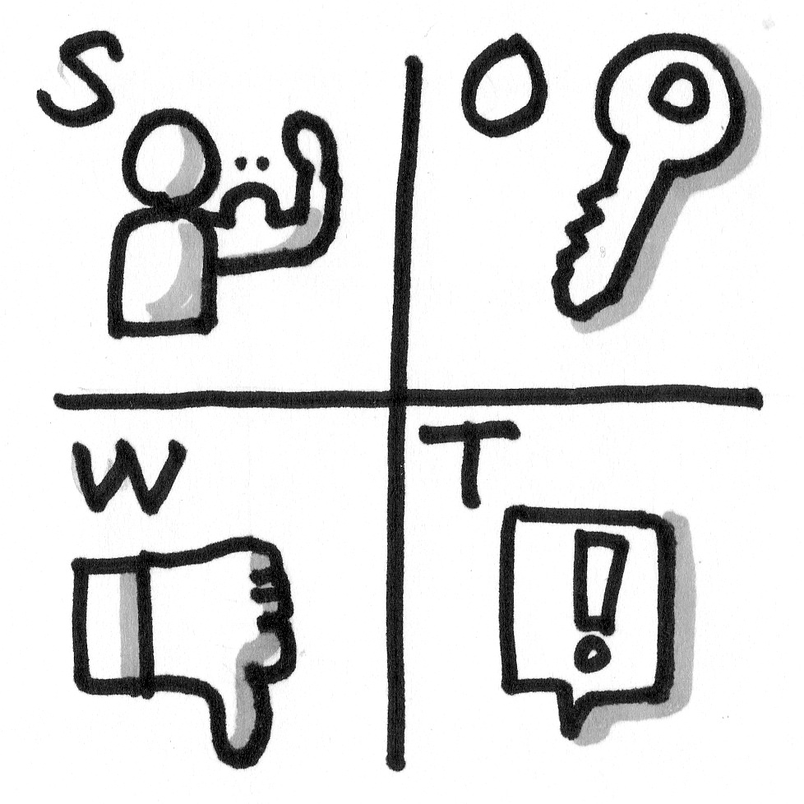
STRENGTHS:
Leads Team meets 2x/month with Campus Staff; increased communication of issues up and down.
Wide range of skills and talents, much collaboration/consultation
WEAKNESSES:
Still some duplication of effort
Some counties/ED still not fully “bought in”; change is hard

Slide 17
OPPORTUNITIES:
More standardization
Greater use of individual Lead talents
THREATS:
Funding
Staff turnover

Slide 18
Questions and Discussion

