Slide 1
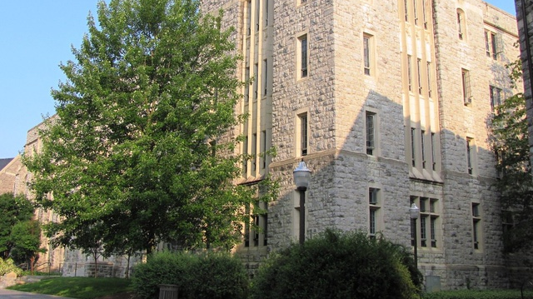
CALS IT – How We Work
College of Agriculture and Life Sciences
Scott Shetrone
Help Desk Manager

Slide 2
CALS On-campus
10 Academic Departments
1 School of Plants and Environmental Sciences
2 Administrative
Farms
Poultry Farm
Turkey Farm
Moore & Kentland Farms
Dairy Complex
Horse Center
Swine Center
Copenhaver Sheep Center
Alphin-Stuart Arena
Judging Pavilion

Slide 3
CALS Off-campus
108 County & City Extension Offices
4 District Offices
6 4-H Centers
11 Research Centers

Slide 4
CALS
About 1600 full-time Faculty and Staff
About 2000 computers

Slide 5
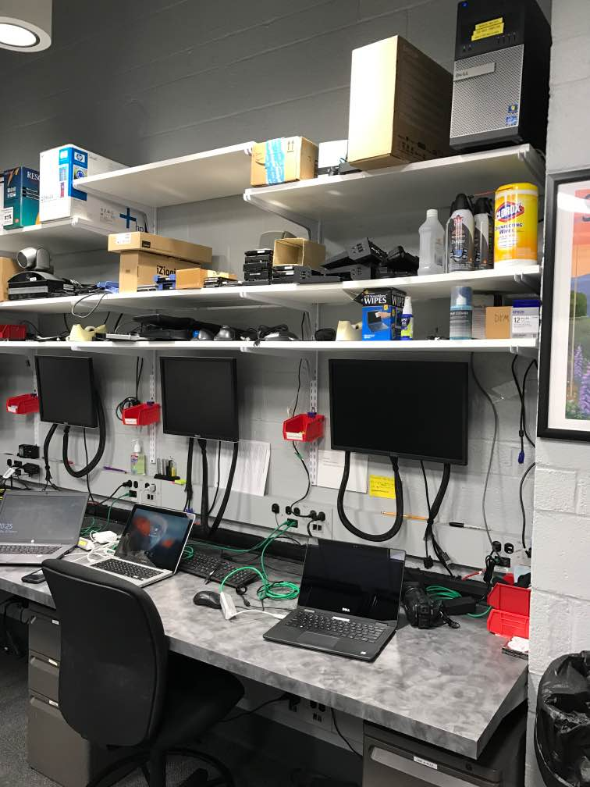
CALS IT
Help Desk
11 full time Faculty and Staff
5 On campus in Blacksburg
Supports all the academic departments and Cooperative Extension
6 stationed in the districts around the state
CALS IT
4 Application Developers
1 Server Administrator
1 Network Administrator
1 Project Manager
1 Instructional Support Technician
1 Application Support Technician

Slide 6
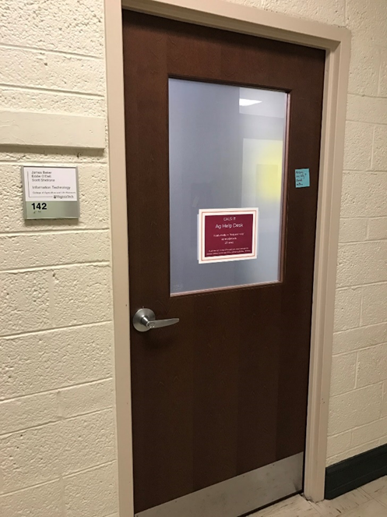
CALS IT Services
Application Development
Instructional Support
Ag Help Desk Services
HW/SW Break Fix
Backup Services
Remote Access
File Storage
Active Directory Services
Patch Management
A/ V Consultation
Laptop Loaner Pool

Slide 7
CALS IT – How we work
Security – Active Directory GPO, BigFix, Symantec
File Sharing – File Server, Google Drive, SharePoint
Documentation – SharePoint
Data Backup – CrashPlan
Communication – Exchange Online and Slack
Video Conferencing – Zoom
Incident Management - ServiceNow
Centralized Logging – elastic, winlogbeat, filebeat
Enabled on all desktop systems

Slide 8
CALS IT – How we work
Patch Management/Endpoint Management – BigFix
Remote Support – Splashtop
Imaging/Deployment – Microsoft Deployment Toolkit

Slide 9
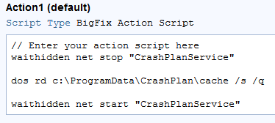
Patch Management
IBM BigFix
Endpoint management
A client runs on each computer
Two parts:
Query language called Relevance Language
ActionScript – can launch scripts and executables

Slide 10
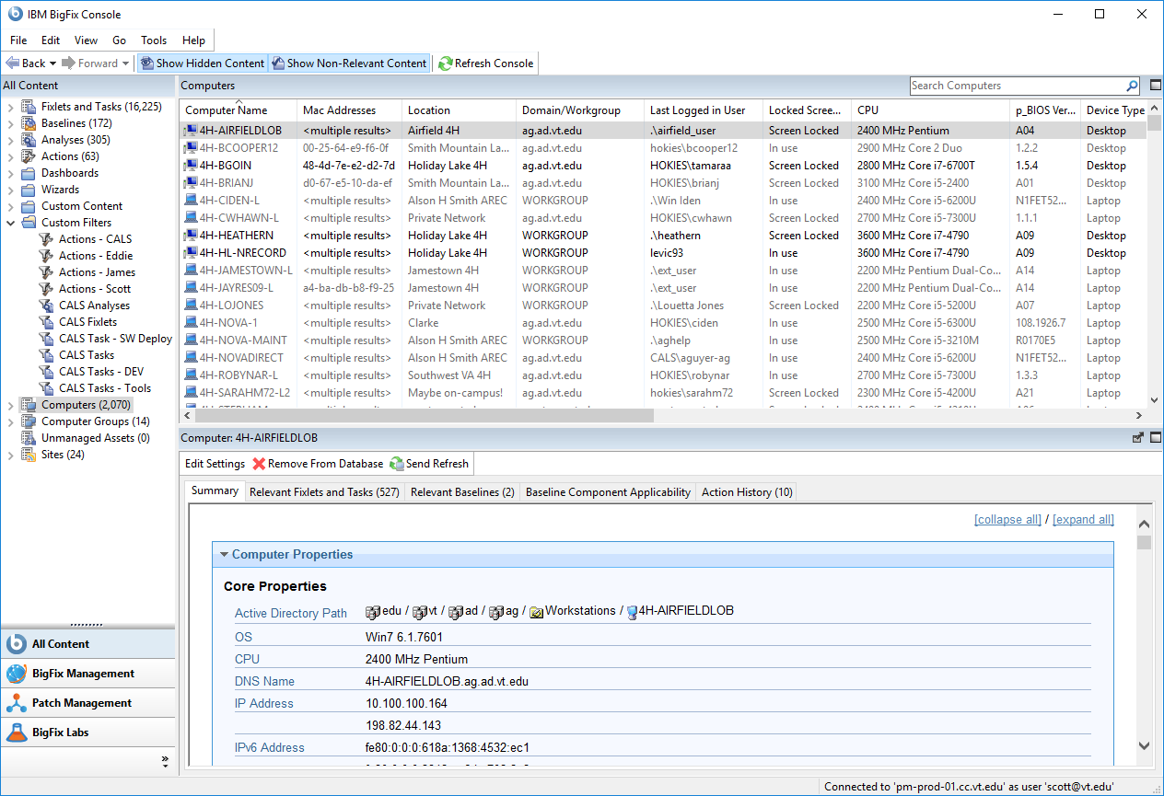
BigFix - Data
IBM BigFix Console
Excel Connector
Web Reports

Slide 11
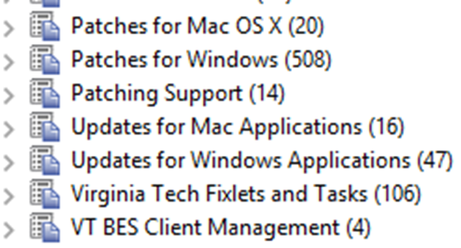
BigFix - Patches
Patches using the OEM source files are available for:
Windows
Mac
Ubuntu
CentOS
Third-party software:
Java
Firefox
Chrome
Etc…

Slide 12
CALS Client Patching Policies
General Patching (if reboot is required)
Action set to begin at 10pm.
Present message to user that a reboot is required, with a timeout of 4 hours. The user can snooze the reboot.
Leave the action open for 2 weeks.
If reboot isn’t needed, apply as available/needed.
Communicate to our clients to leave computers on and connected overnight/weekends.

Slide 13
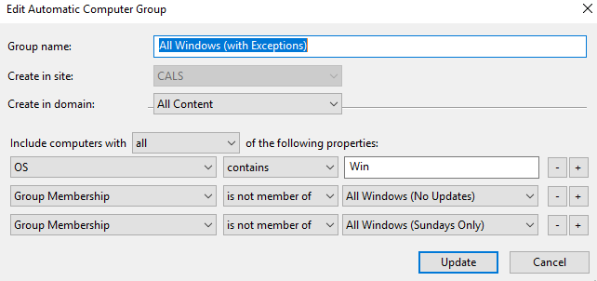
CALS Client Patching Policies Exceptions
Sundays Only – this is generally for lab computers.
No Updates – For servers and computers that run long computational jobs or data collection jobs. Our users get department head approval to be exempted from our patching schedule.
Done by creating Computer Groups in BigFix

Slide 14
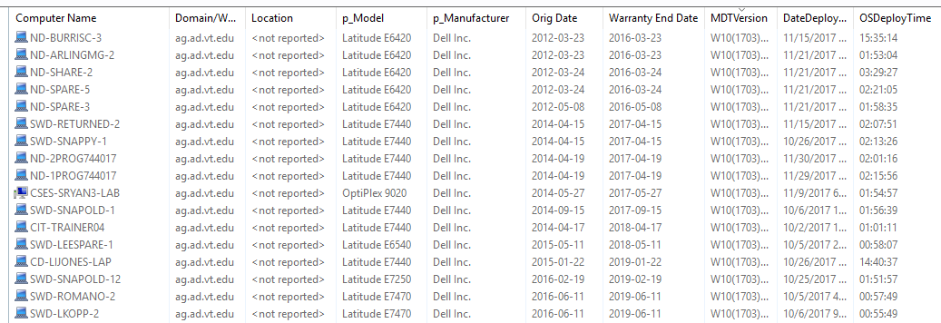
Warranty Information

Slide 15
Warranty Information
Get access to Dell API:
TechDirect (https://techdirect.dell.com/portal.30/Login.aspx​)
PowerShell script
Get the system’s serial number
Grab system info with API at Dell’s site (system info in XML file)
Parse out the Purchase Date and Warrant End Date and load into the registry
(HKLM:\Software\CALSIT)
Write a BigFix analysis to get that info from the registry
There is a task to add manually add as well
For Macs, had to go with when the system was introduced by Model number

Slide 16
Software Deployment
Tasks to deploy:
Office 2016 Pro Plus
Adobe DC Pro 2017
SAS
Splashtop – Remote Access tool
Dell Command - Update – updates Dell BIOS
Central Logging Service - elastic
Winlogbeat
Filebeat (for Macs)
Analyses to check installation status, version, and if it’s running

Slide 17
Security
Password Change Tool
CALS IT and ITSO wrote and tested
Windows and Mac
Changes a password for a local account to a unique password that can be calculated by IT staff as needed
Uses the net user command to set the specified user account’s password
Takes a hash of the machine’s serial number and secret phrase
Macs use the dscl command to accomplish the same thing

Slide 18
Location of computer
Analysis:

Slide 19
Splashtop – Remote Support
Need for new Remote Support option
RDP
Doesn’t allow end user to see what is happening
The university blocks RDP (and SSH) at the edge
Difficult to protect with 2FA
SimpleHelp
Requires user intervention to connect remotely
Doesn’t allow for a persistent client

Slide 20
Remote Support
Requirements:
Persistent client
NAT Traversal
Secure
Enforceable 2FA
Cross platform
Affordable
Easy to deploy
Jump client
Logging
SplashTop
Streamer was deployed with BigFix
Unlimited Technicians
Ability to lock a user to one computer or group of computers

Slide 21
Remote Support
Purchased in July 2017
Rolled out by end of August 2017
Numbers
3333 Total Sessions, ~11 per day
3087 persistent client, 246 SOS client
Average time in session is about 15 min
Replace RDP for faculty & staff

Slide 22
Splashtop – Pain points
Off-boarding is manual
No APIs
No SSO - Users must create a 3rd party user account
Computer renaming

Slide 23
Imaging Computers
Microsoft Deployment Toolkit

Slide 24
Imaging
All new Windows computers are imaged with MDT
USB based deployments
Network bandwidth issues
Network infrastructure doesn’t allow for PXE boot
Latest image is 83GB, ~60GB are drivers
Time to deploy is about 45 min
New image is created:
Windows 10 feature update
HW refresh from Dell (to get the latest drivers)

Slide 25
Imaging
Installs Custom Windows image with the appropriate drivers
160+ Models (sigh…)
Runs Windows Updates
Checks for updated versions of select software packages and updates the drive if needed
Joins computer to our Domain
Post Image tasks:
Printer installations
Email and Backup configuration
Data transfer

Slide 26
Questions?
CALS IT
Ag Help Desk
Scott Shetrone Ag Help Desk Manager
aghelp@vt.edu

