Slide 1
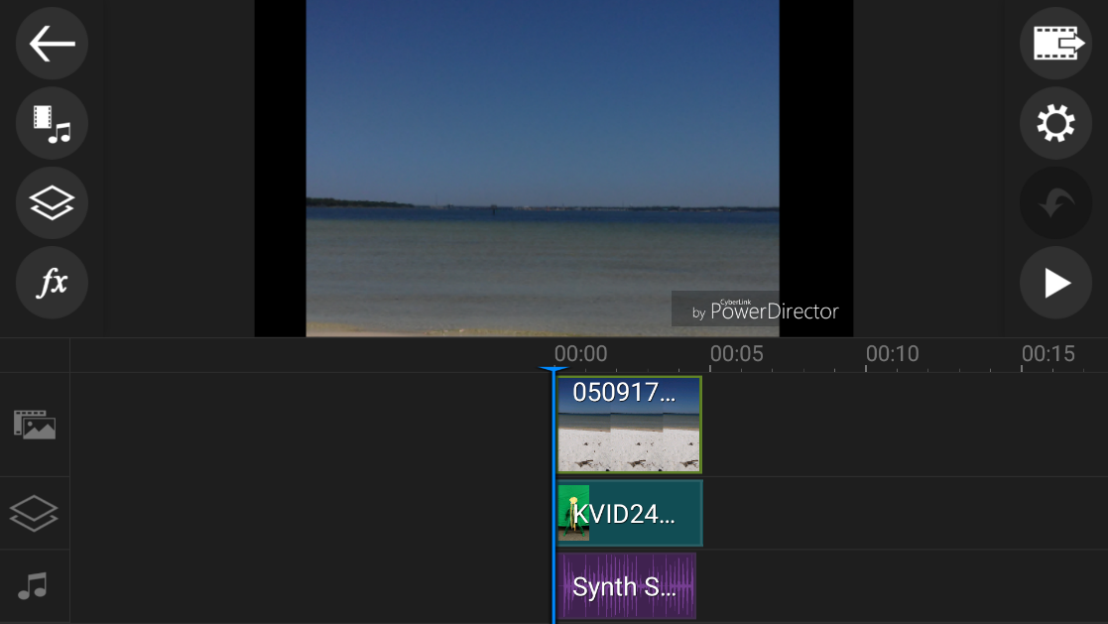
Working with What You Got – Hands-on Video Production
Jennifer Bearden, Jill Breslawski,
John Wells

Slide 2
Making Educational Videos in the Field
What You Got – Tools
What’s Your Message
Shooting Video
Editing Video
Sharing Video

Slide 3
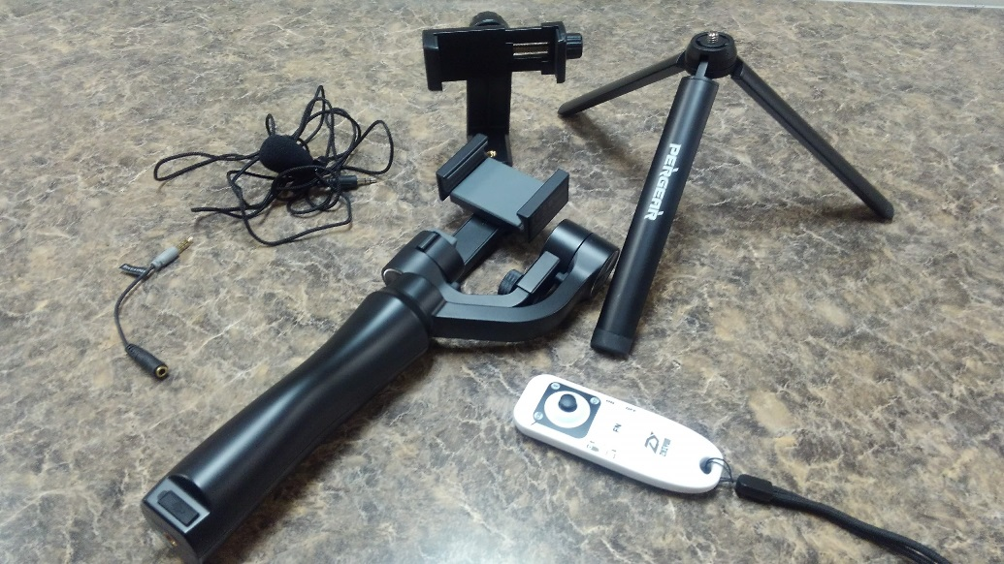
What You Got - Tools
Smartphone – Android, iphone
Tablet
Tripod mount adapter
Tripod
Gimbal/Stabilizer plus remote
Microphone plus adapter

Slide 4
Chromakey Green Screen Kit
$129

Slide 5
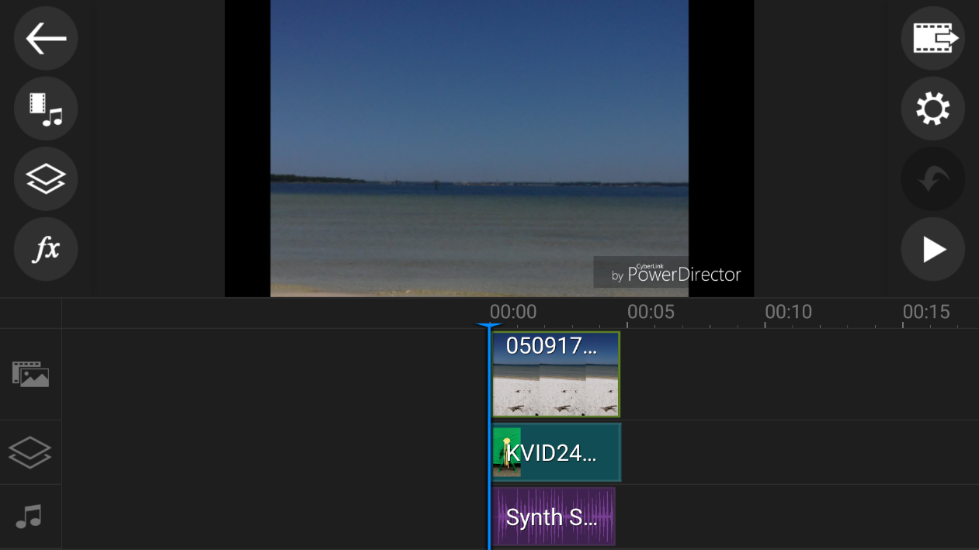
What’s your message?
Script or Story Board
Want you location to tie into your message
Layers can be video and photos

Slide 6
Editing
Editing begins before you are shooting
Apps – iMovie, Filmora, PowerDirector, Chromavid
Wrapper – opening and ending

Slide 7
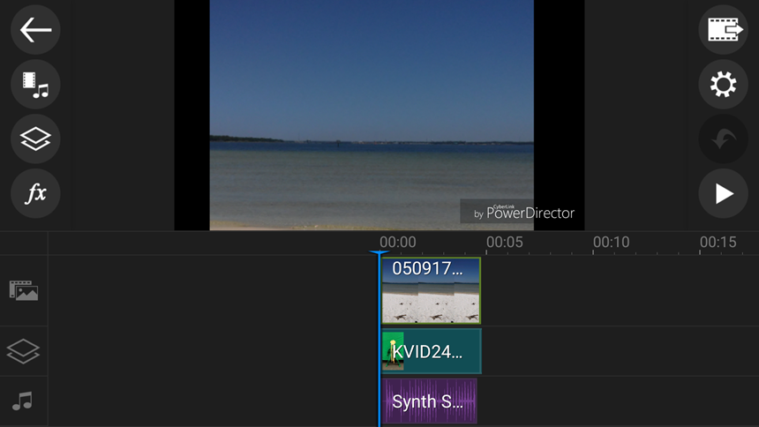
PC vs smart device

Slide 8
Wrappers makes life easier!

Slide 9
Shooting and Editing
Practice makes perfect so let’s practice!

Slide 10
Exercise
What tools do you have?
What’s your message?
Audio/Visual components
Edit
Share

Slide 11
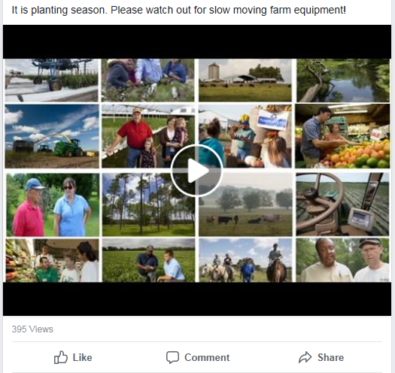
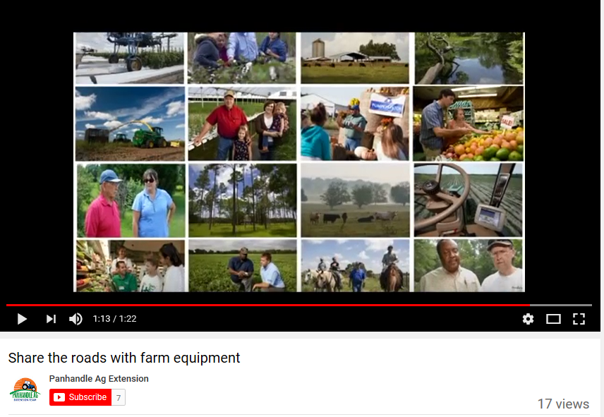
Posting Tips
YouTube
Website
Facebook
Twitter

Slide 12
Thank you!
http://edis.ifas.ufl.edu/topic_video_production

